Slide 1
Taking Care of ALL the Generations on the Farm
A discussion about simple, automated devices to make caregiving and farm tasks safer and easier. Exploring remote cameras, smart outlets and bulbs, door monitors and sensors, feeding and watering systems, apps and more.

Slide 2
Overview:
Who we are and how we have used this technology!
Uses for supporting dependent family members
Uses for supporting a farm or ranch operation
What we will cover: types of devices and some examples and ideas how they can be used
What we won’t cover: specific set up, information about WiFi and Voice Controlled Assistants (i.e. Alexa, Hey Google)
We will mention if a device requires an application for setup/control, and if they can be Bluetooth or WiFi
Please ask any question in the chat area, and we will answer as we go!

Slide 3
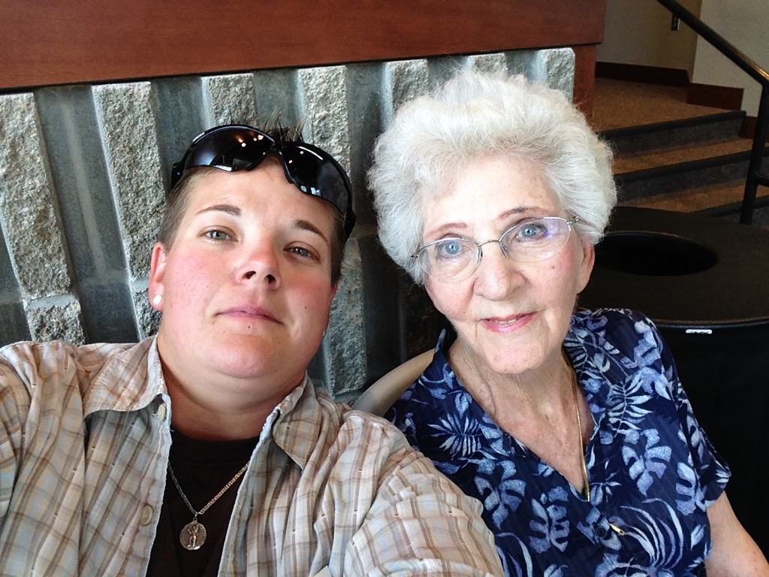
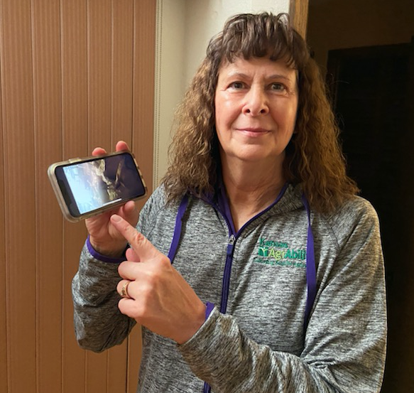
Introductions:
Cassie Ramon – North Central & Northeast AgrAbility
Karin Rasmussen - Western AgrAbility

Slide 4
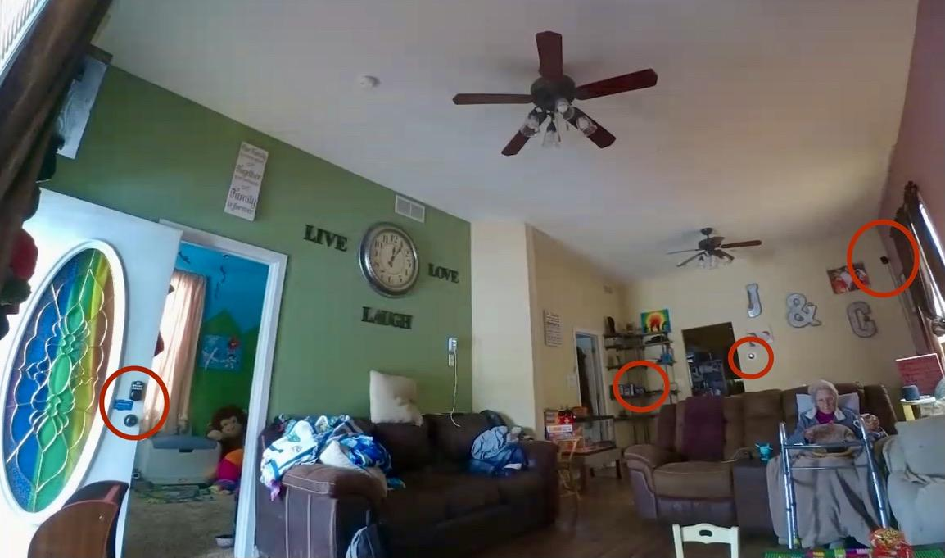
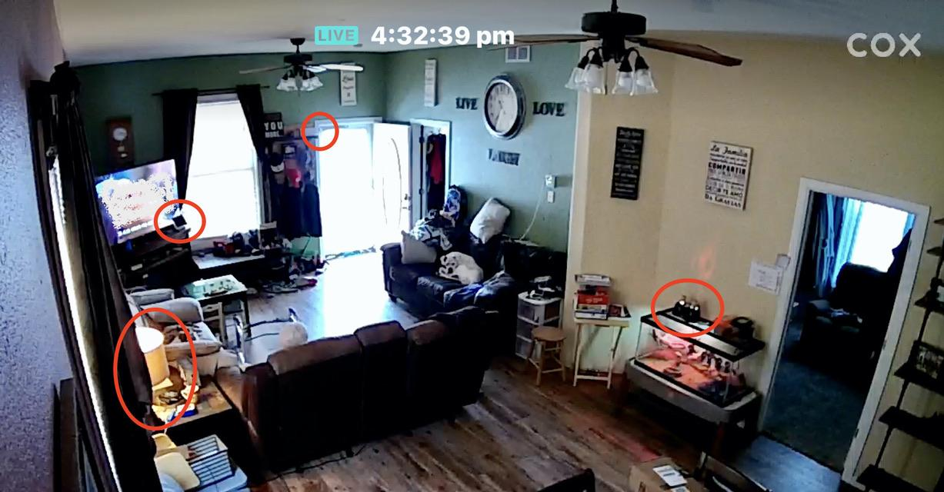
One of the most valuable tools: Cameras
Check in from anywhere
Watch for falls, or wandering
Using appliances, or eating meals
Two-way communication
Give instructions or reminders
Reassurance in case of a fall
Ensure other devices are on/working
Changing TV channels
Turning on lights

Slide 5
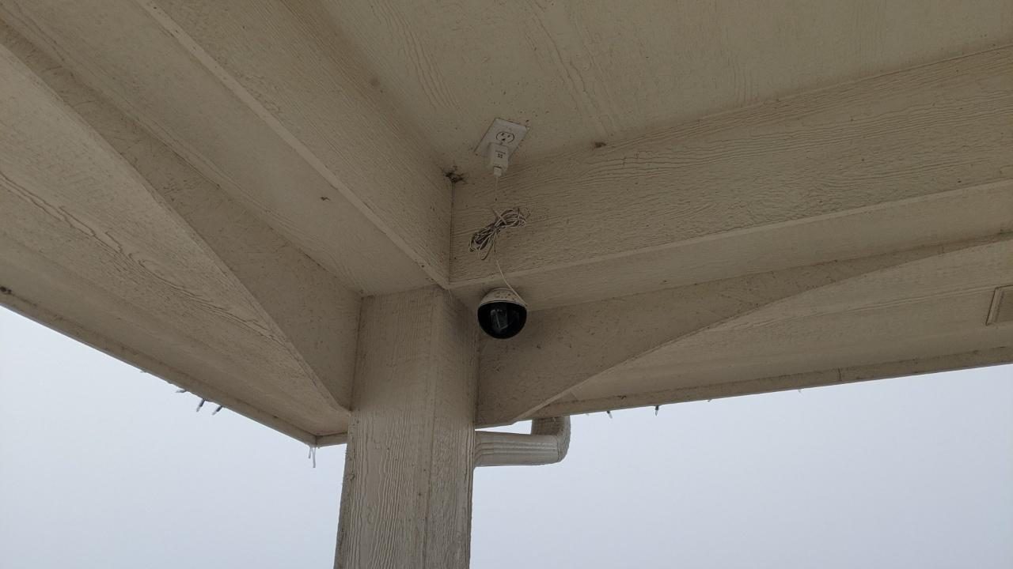
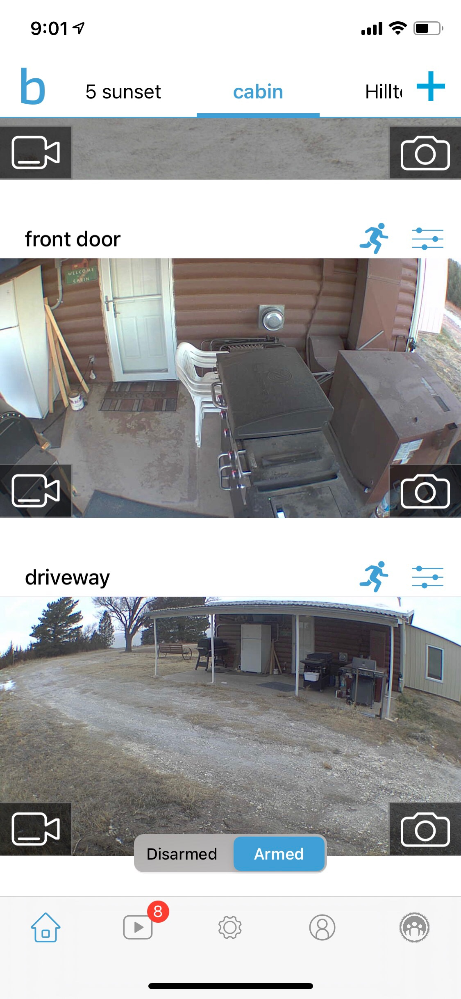
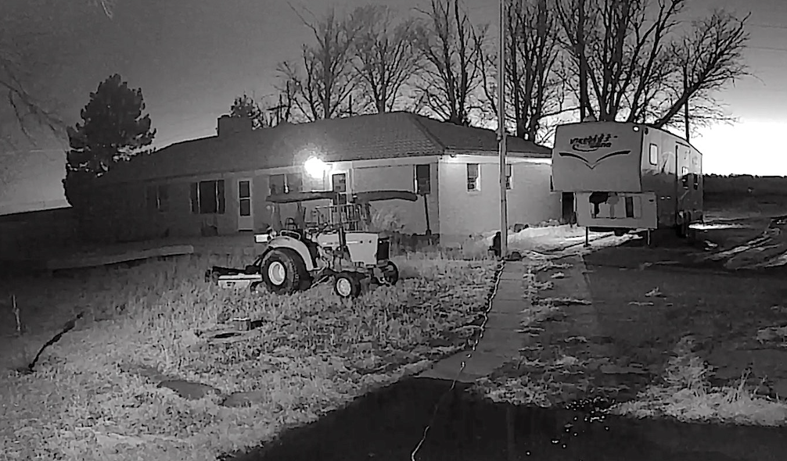
Top left: Samsung camera facing front door.
Bottom left: Wyze Camera on a pole facing a home.
Right: Blink camera screen shot of entrance to a cabin.
Most cameras now offer recording and playback, live screen, motion detection, 2-way audio, and swivel.
Blink camera doesn’t swivel.

Slide 6
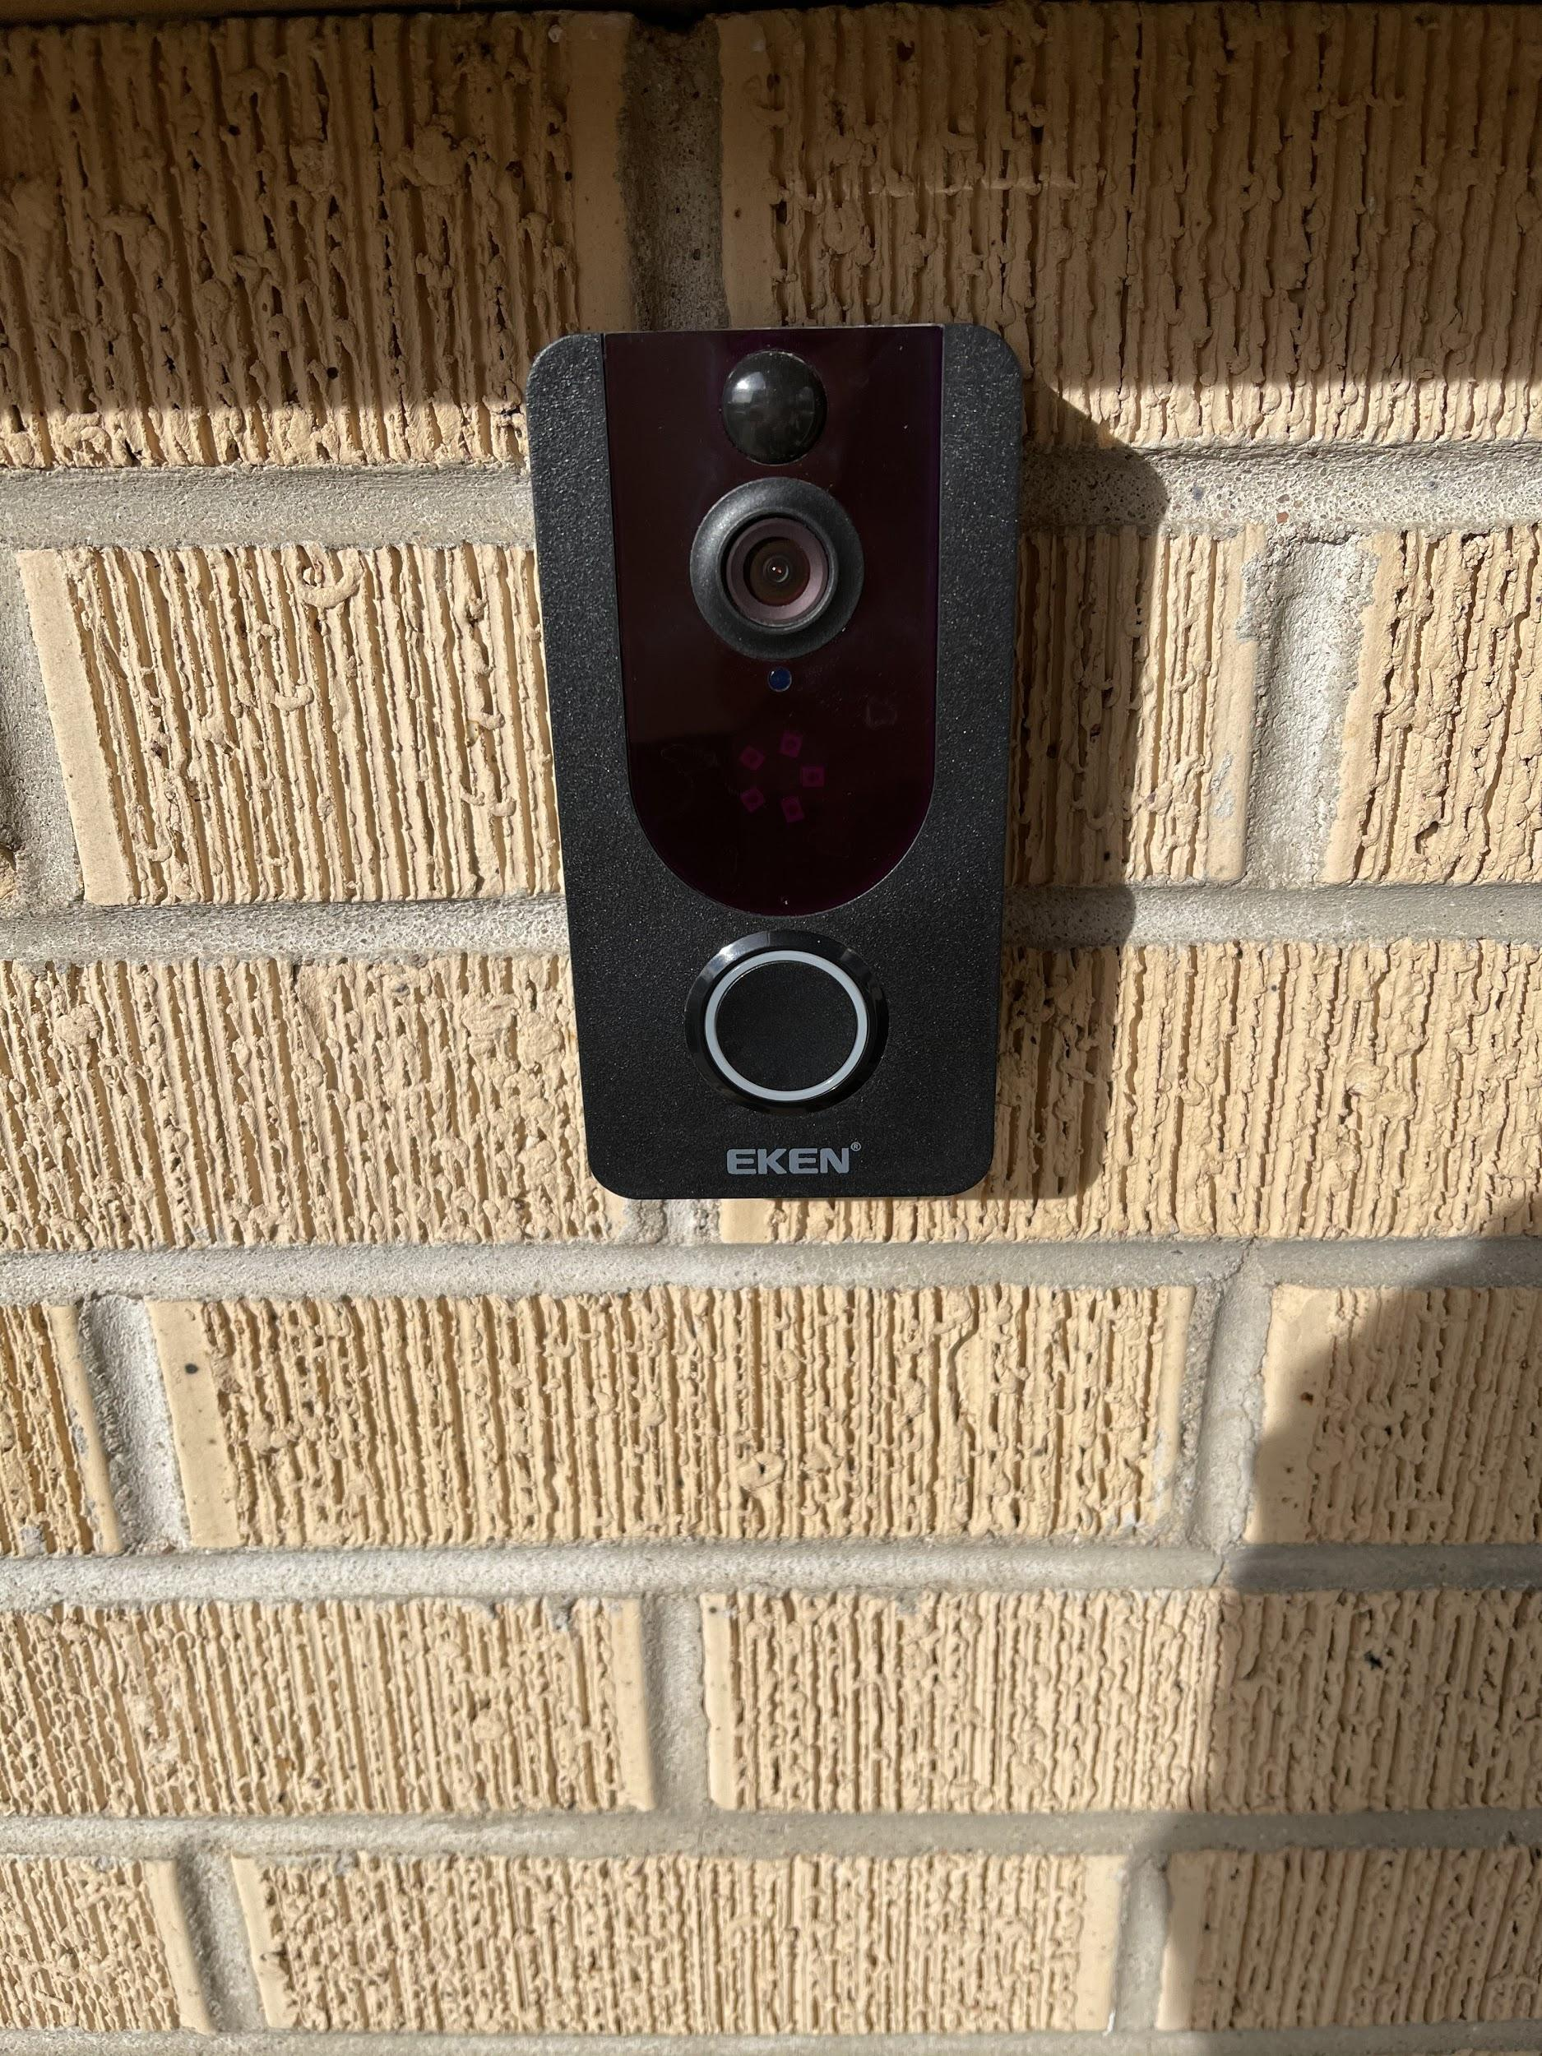
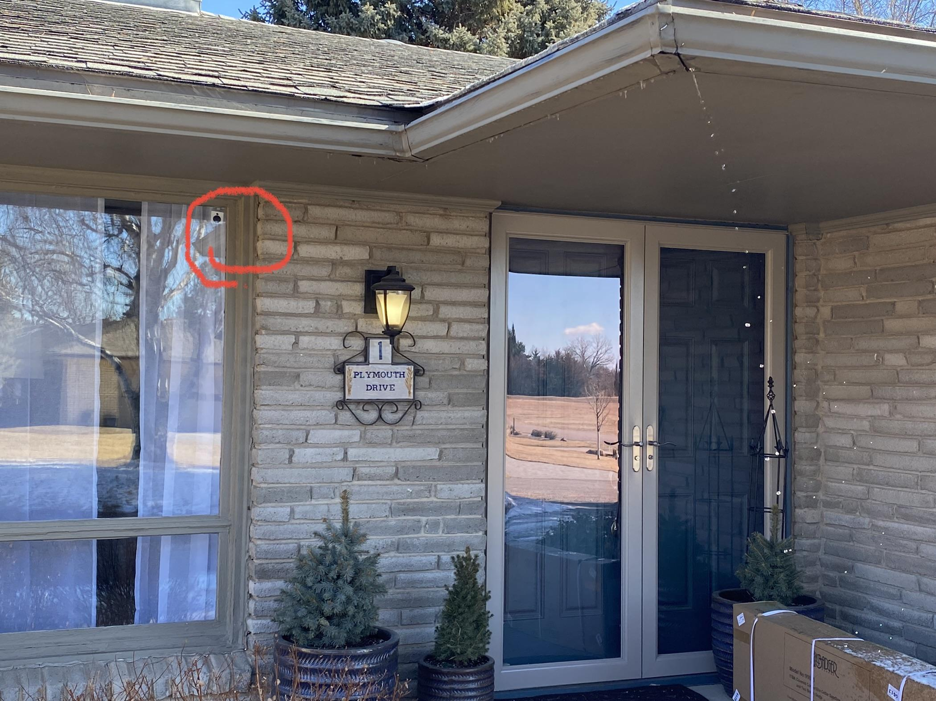
Wyse camera mounted inside the home with motion detector, night vision, and two-way audio.
Eken Outdoor Doorbell with security camera, night vision and two-way talk.

Slide 7
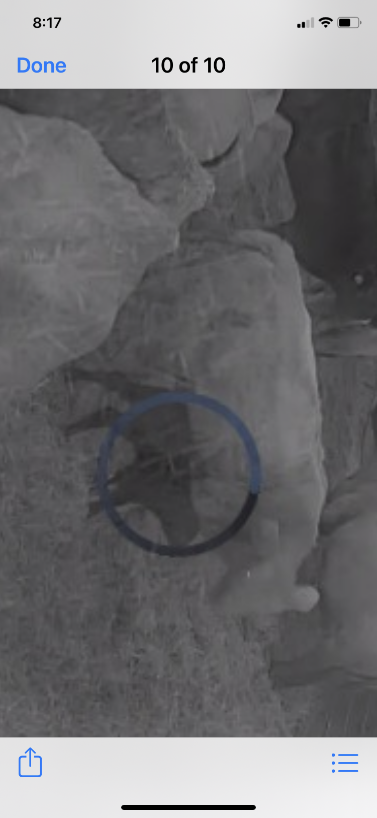
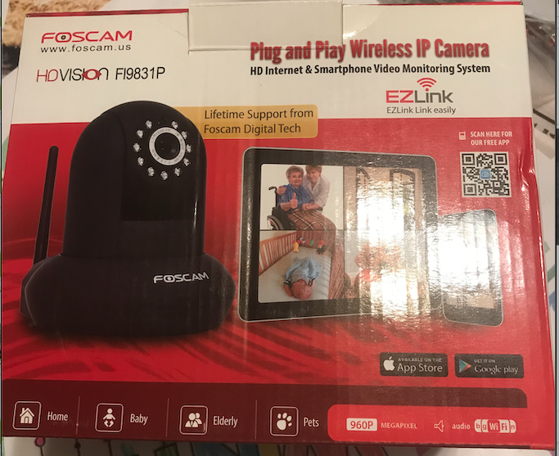
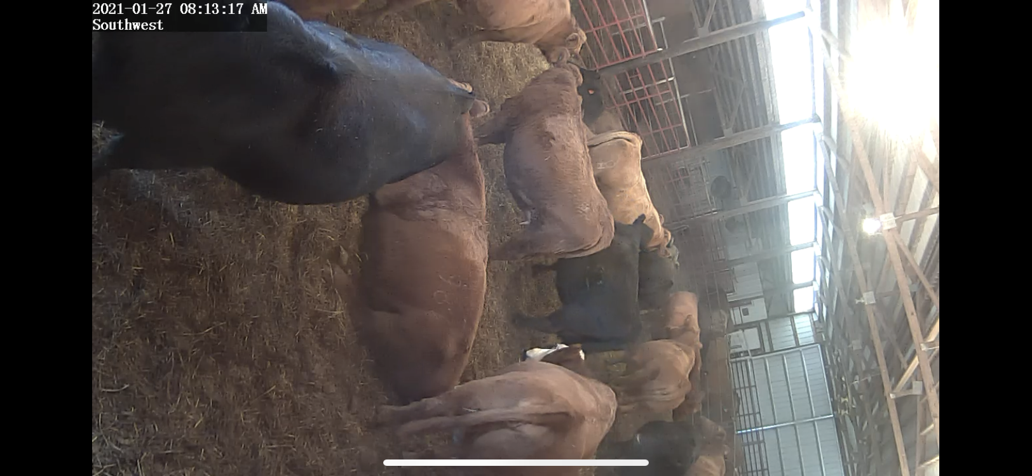
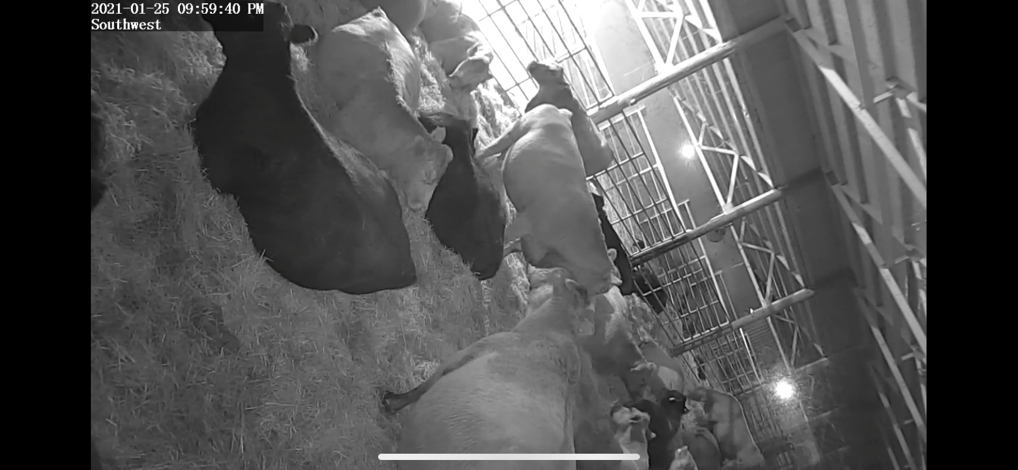
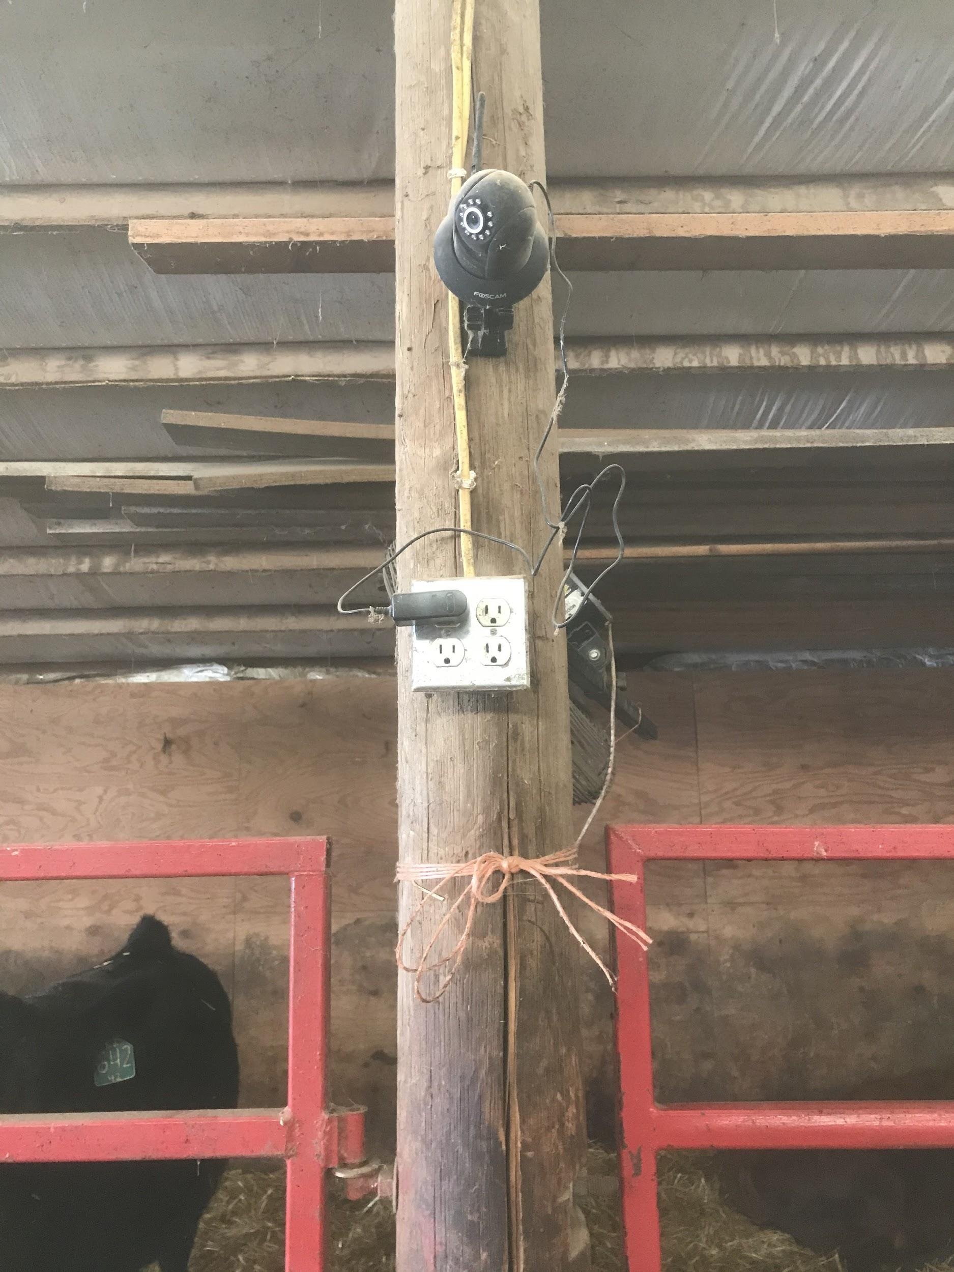
Foscam in a calving barn.
Camera can swivel. Used in view only mode but has audio and motion detector option. Has night vision and zoom capabilities.
Screenshots of calving barn with cows and a new baby calf using the Foscam app. There are 3 cameras in this barn for farmer brothers to view from 1 - 2 miles away.

Slide 8
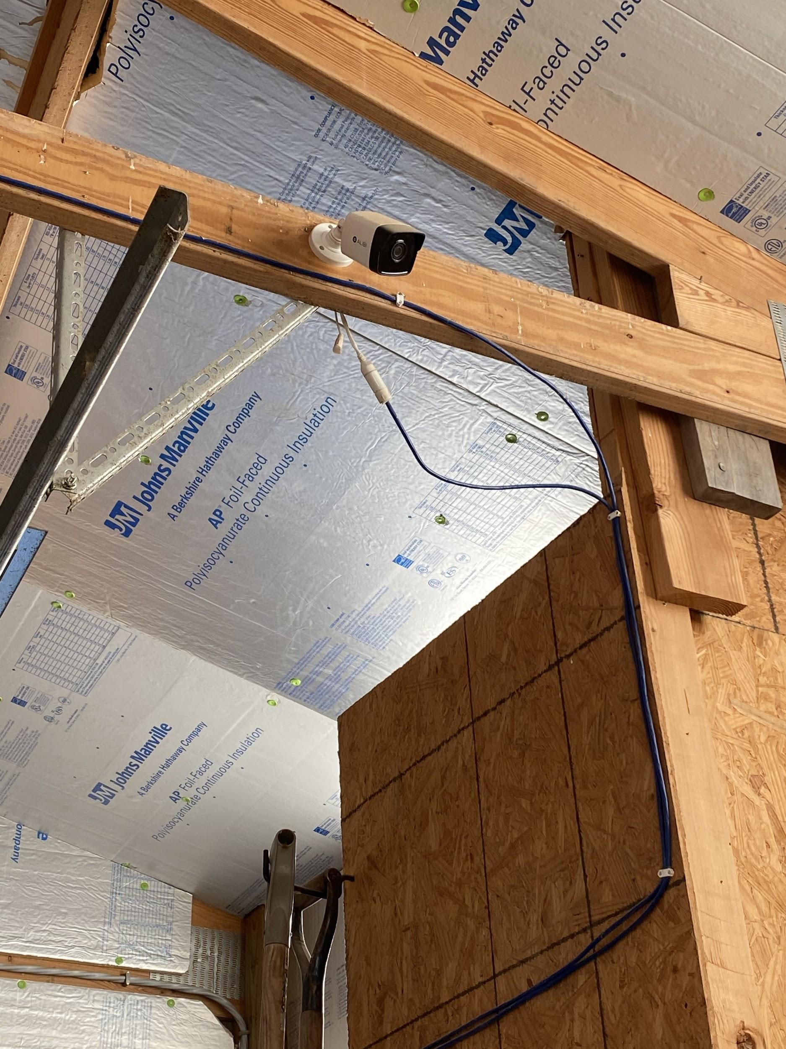
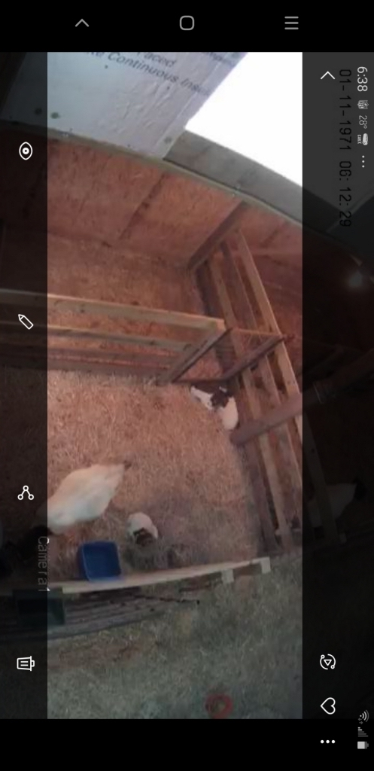
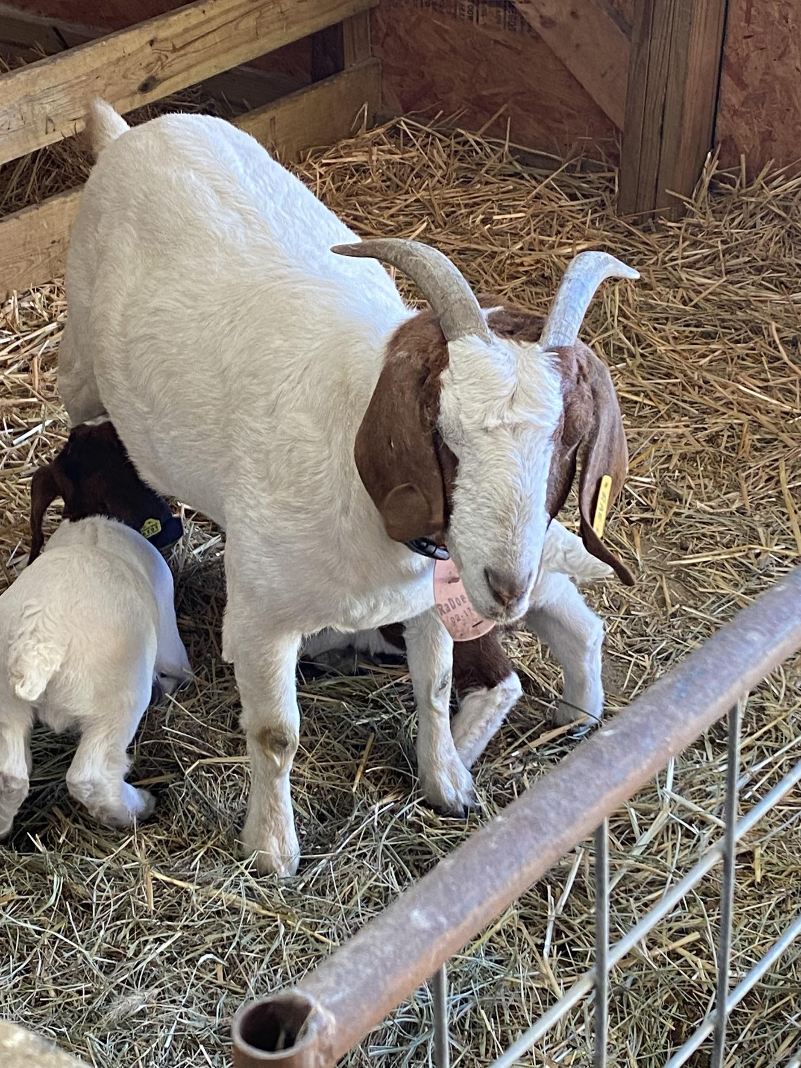
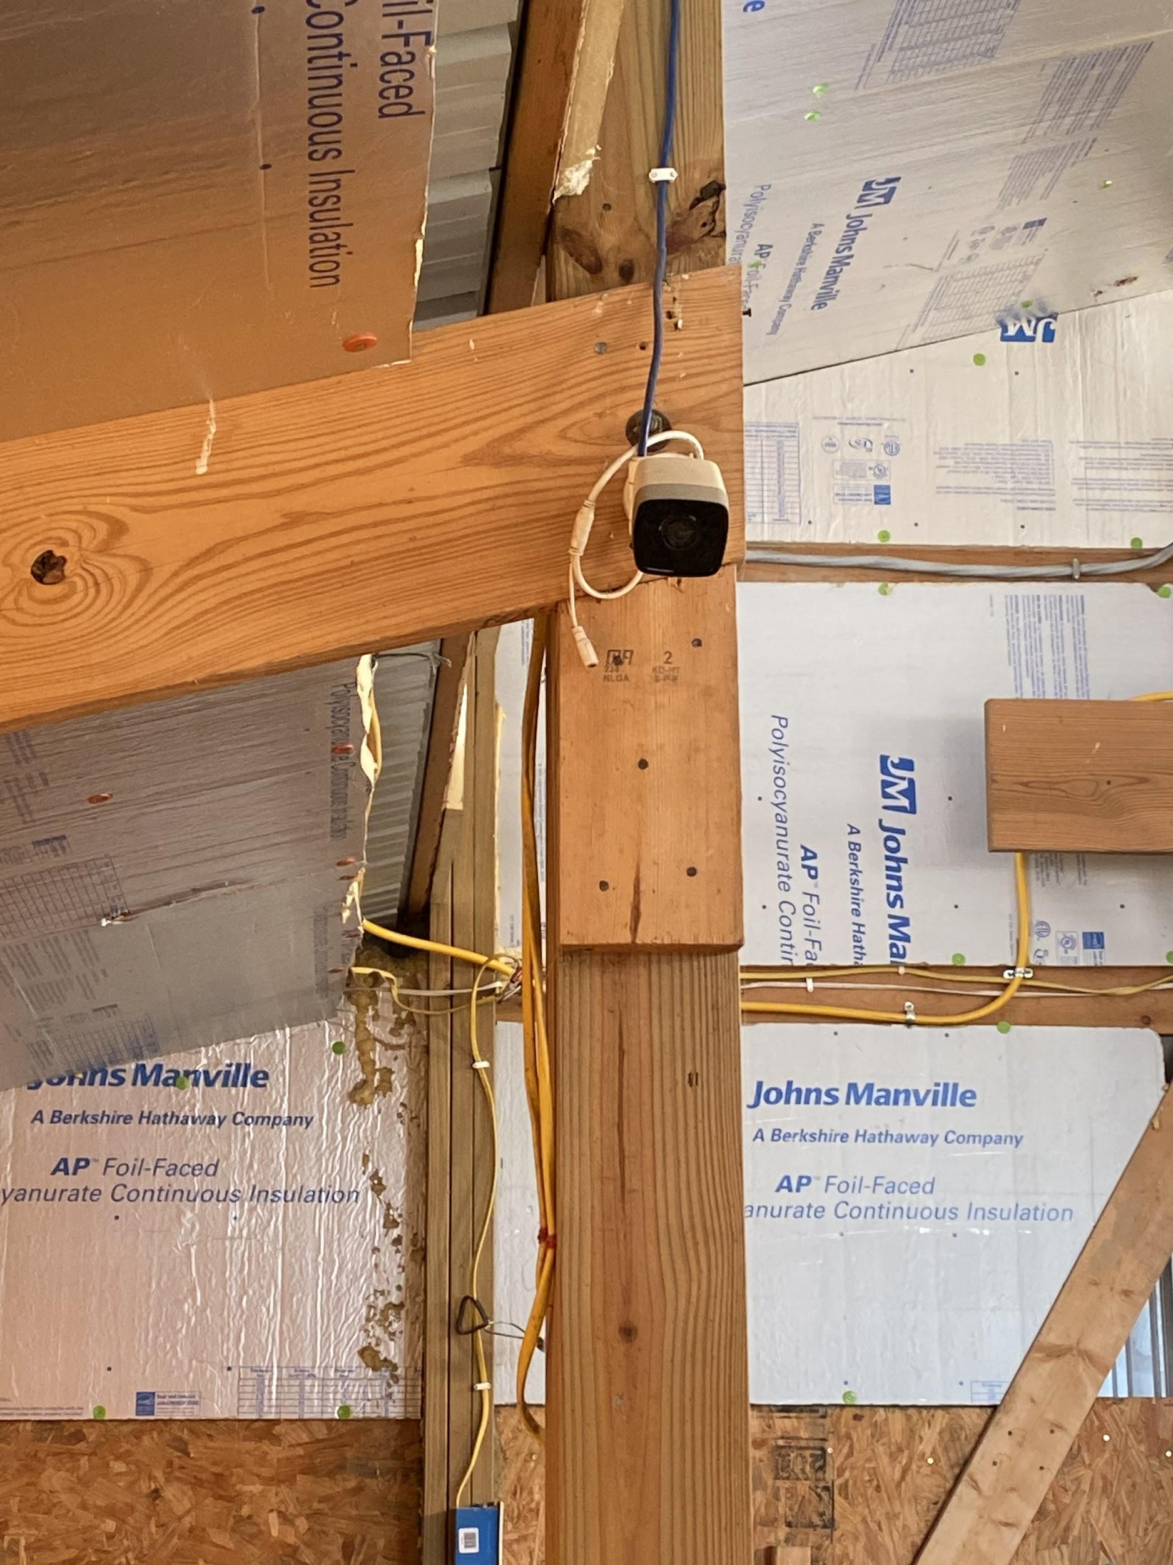
Camera(s) mounted in barn with goats. Rancher has camera set in view only to monitor the goats when they are kidding.
Right picture is a screenshot of camera view.

Slide 9
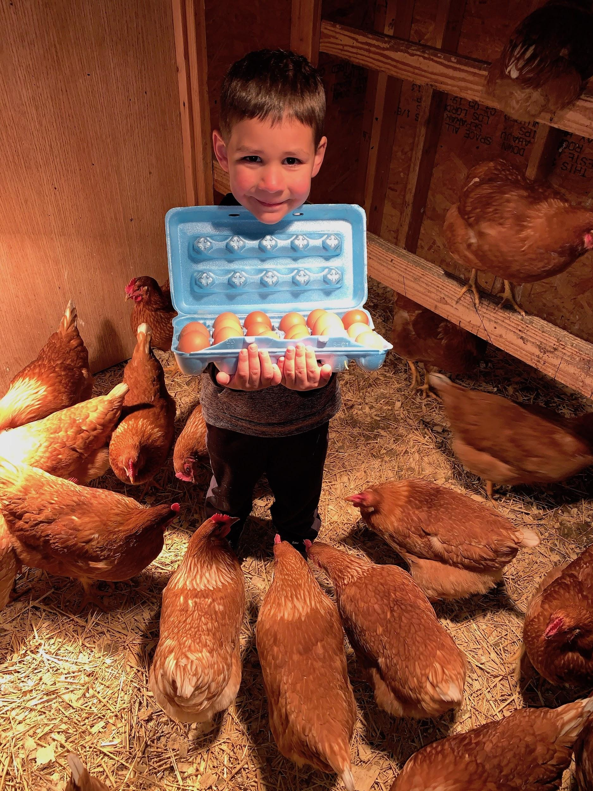
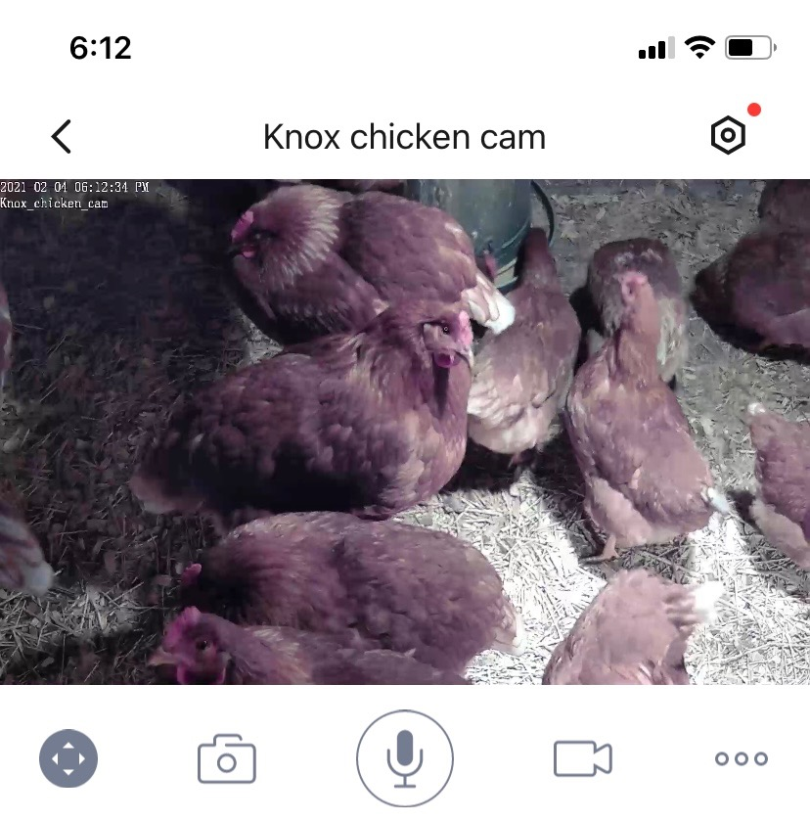
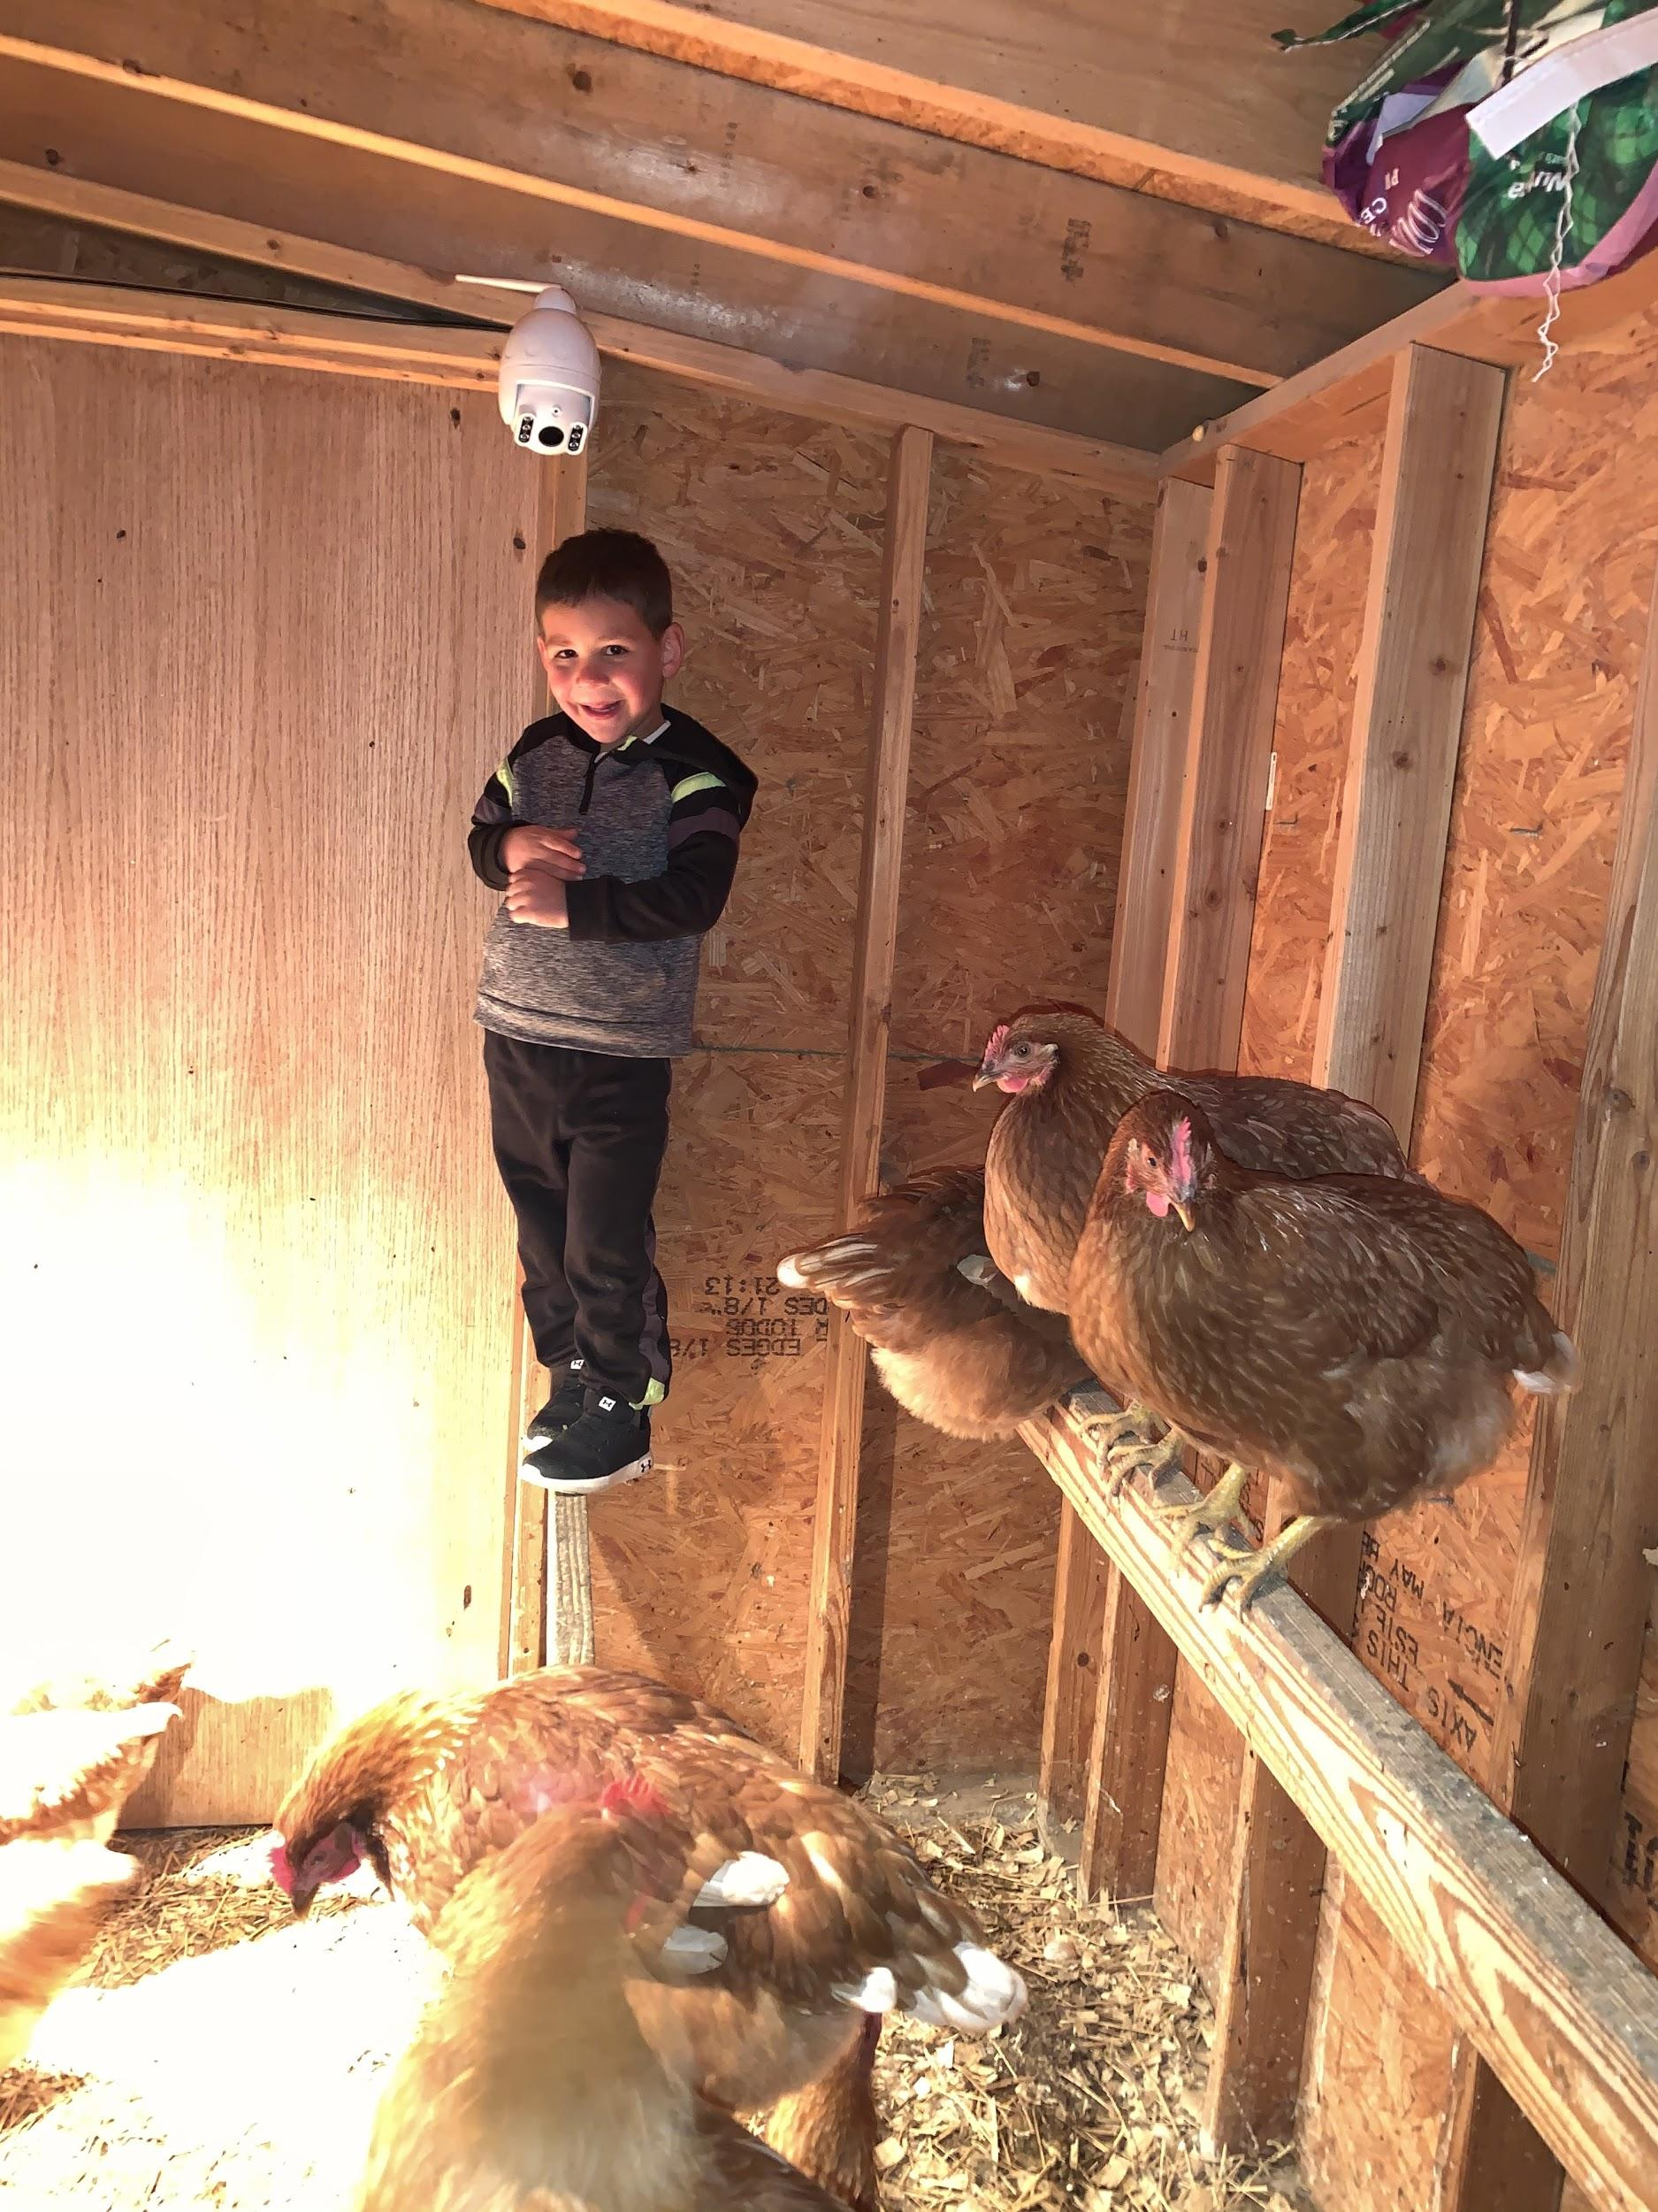
Bottom center: Foscam outdoor camera with zoom, tilt, audio, night vision, recording and motions sensor options.
Right: Screenshot from phone app monitoring the chickens.
Meet Knox and his Egg Production Business. Currently he has 30 Golden Sex Link hens. He helps feed, water and gather eggs daily. He sells his eggs in town.

Slide 10
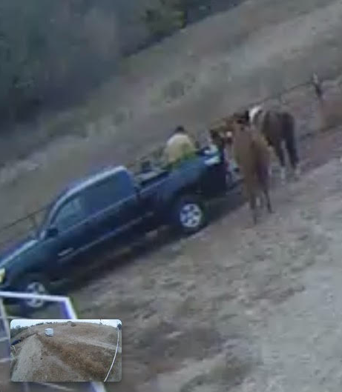
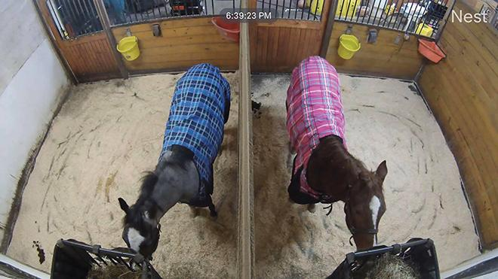
During foaling season, this owner shares the camera app and the log on link with a remote helper so that she can have two-way communication if there is an emergency.
This horse owner can check on horses in the paddock, while at her job 30 miles away.

Slide 11
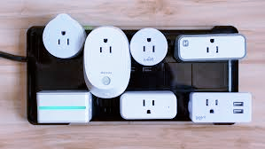
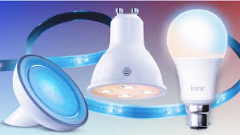
Auxiliary Devices: Plugs and Light Bulbs
Power on and off things like fans, table lights, and humidifiers
Getting dark, help prevent falls
Fans on and off through the day
Light Bulbs
Different lighting effects
Set up routines, on/off at certain times

Slide 12
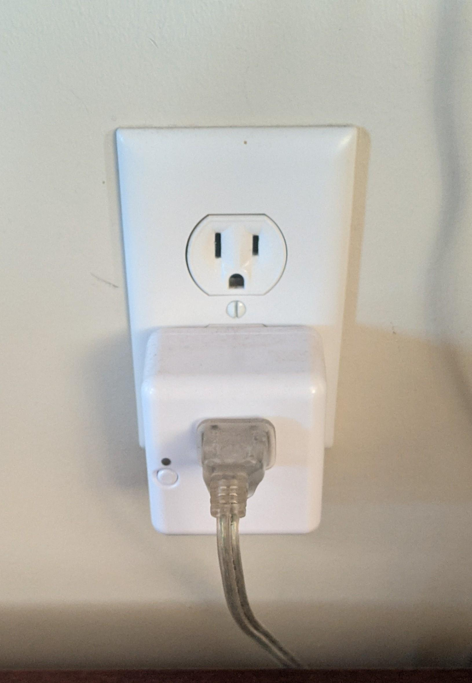
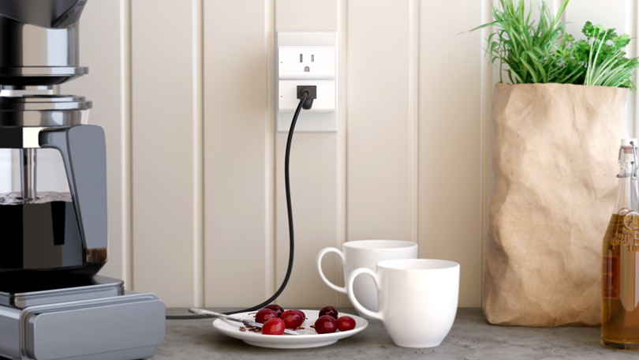
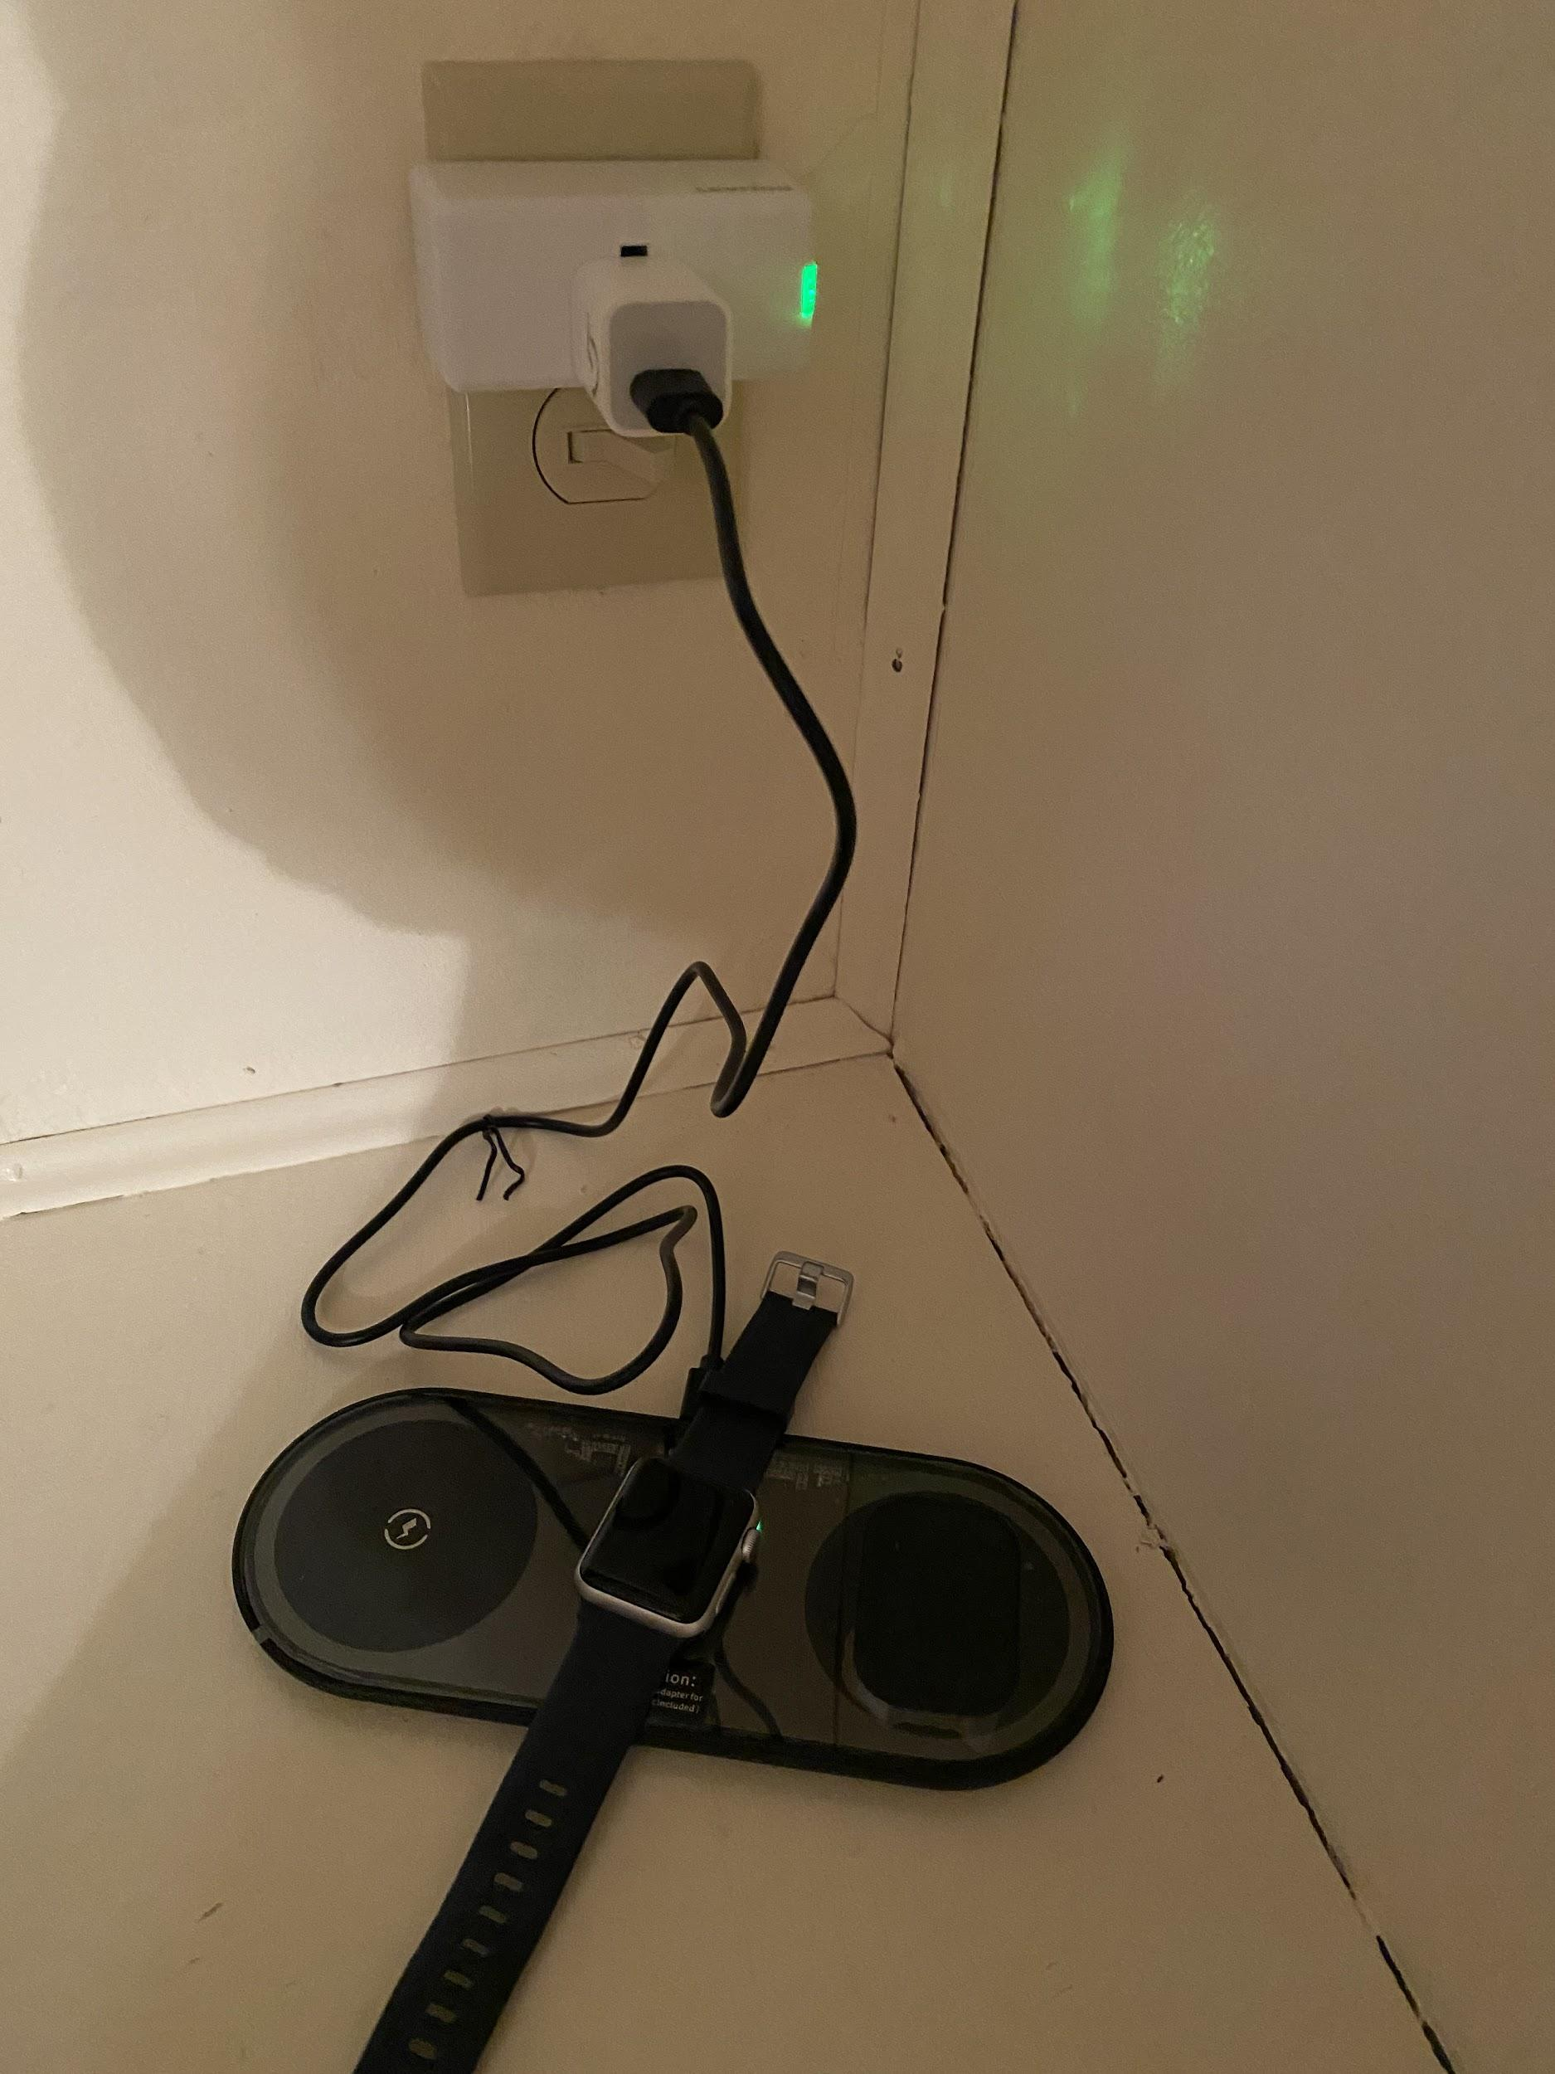
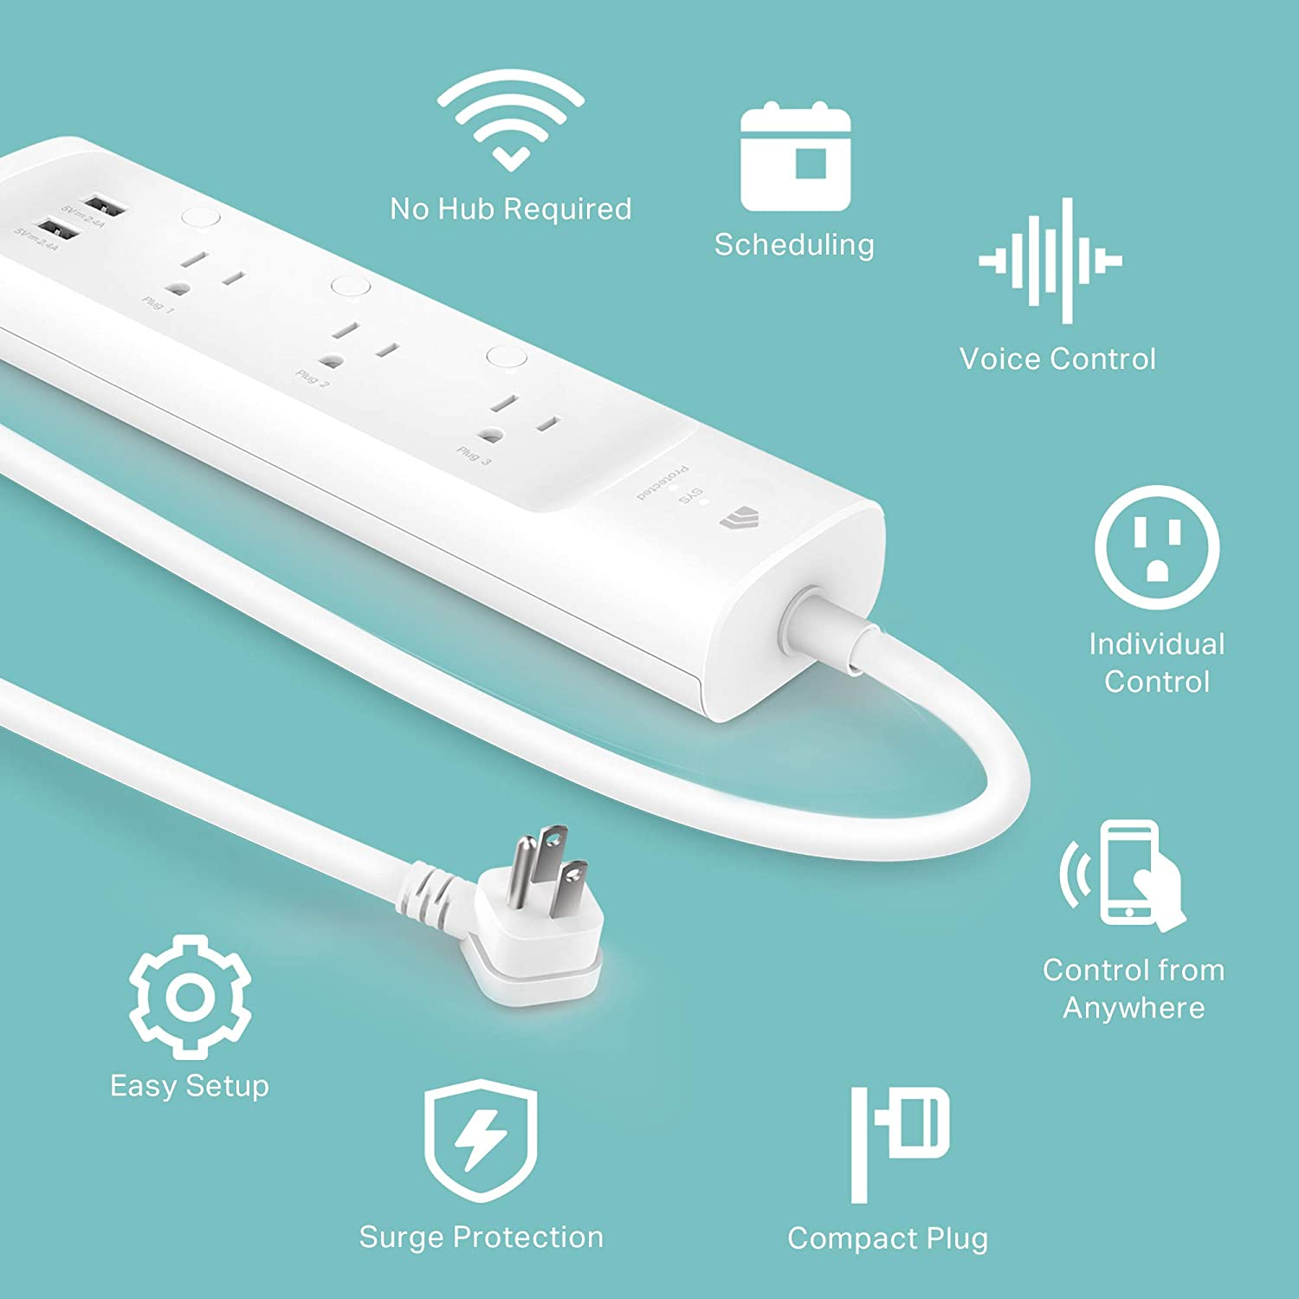
Smart Outlets allow schedules to be set for on/off, turn on automatically if gone, or turn on verbally through Alexa. Example options: lamps, Scentsy, diffuser, Christmas Trees, coffee pot. ceiling fan, instant pot, humidifier, space heater, charging stations, etc.
Kasa Smart KP303 Plug Power Strip, Surge Protector, Smart Outlets and 2 USB Ports, Works with Alexa Echo & Google Home, No Hub Required
“Alexa, turn on music.” Use Smart plug app to turn off automatically in 30 minutes.

Slide 13
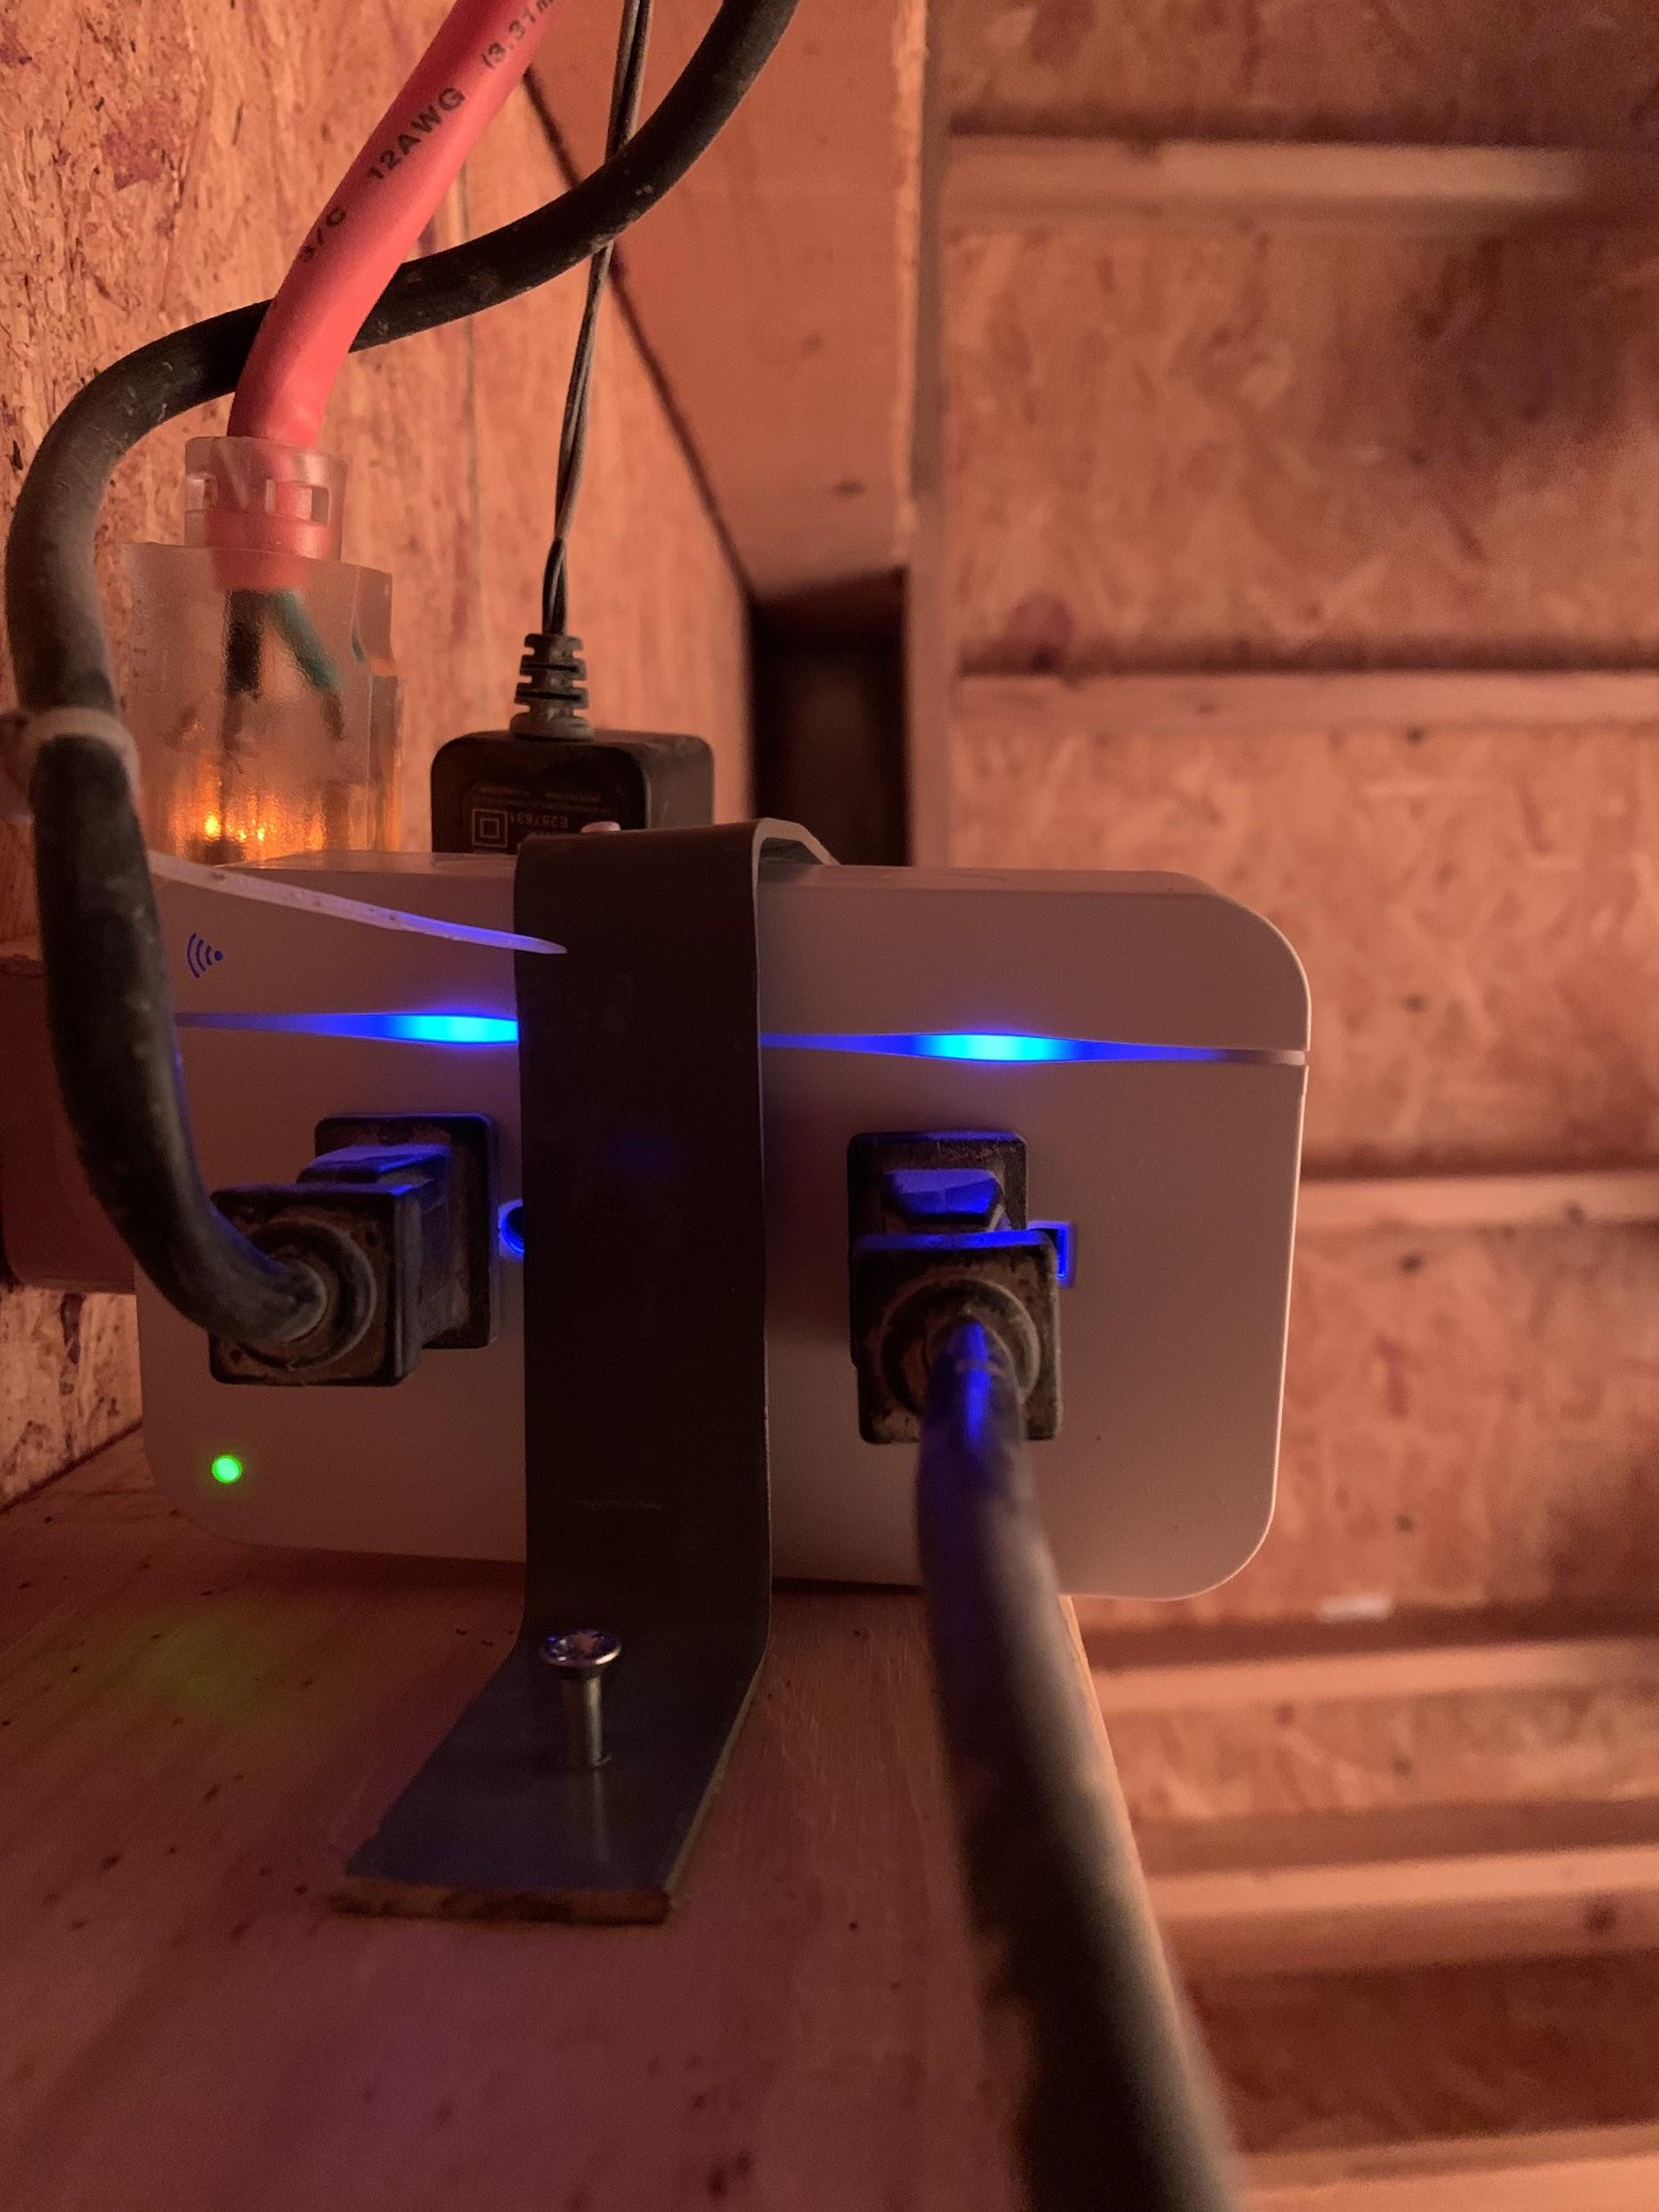
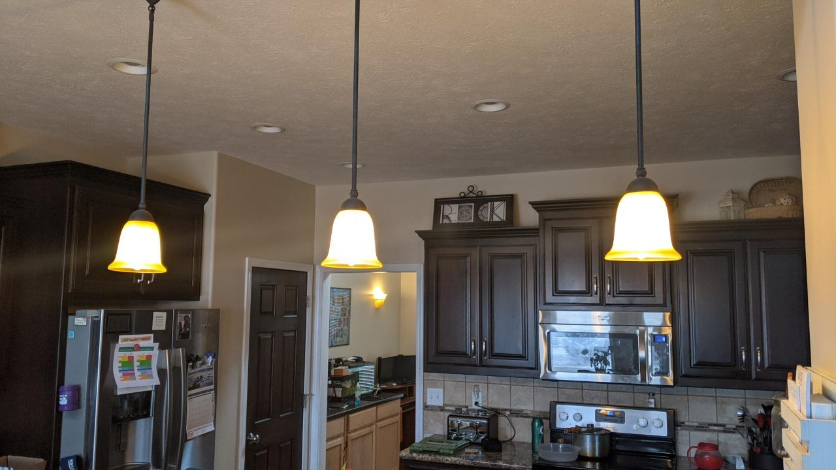
The three lights in the kitchen are Philips Hue LED Smart Bulbs that can automatically be turned on and off. Mostly use them when away from home to simulate normal activities. The Samsung SmartThings system is being used to automatically turn those on at sunset and turn them off at 11pm.
ConnectSense - 2-Smart Outlet Plug powered by extension cord to operate 2 heat lamps in chicken coop.

Slide 14
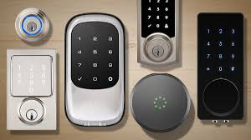
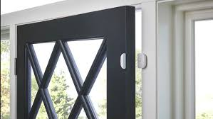
Security Devices: Door Locks and Sensors
Locks and Deadbolts
Monitor wandering
Check on kids at home
Assign codes to others to monitor
Door and Window Sensors
Verify opened or closed
Security systems
Receive alerts when away
Glass Break and Motion Sensors
Water and Smoke Detectors

Slide 15
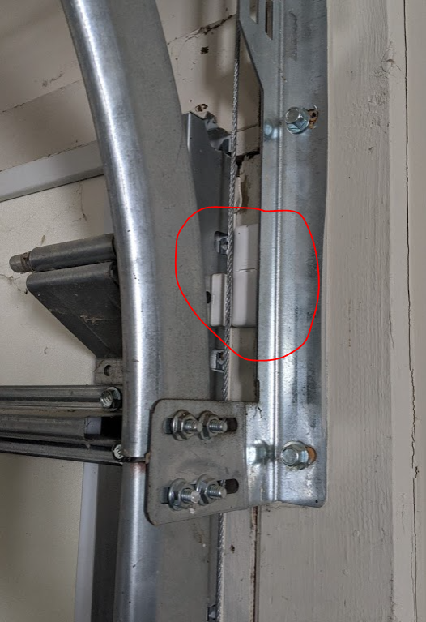
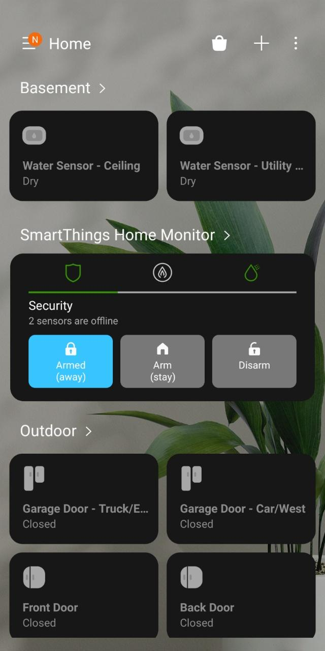
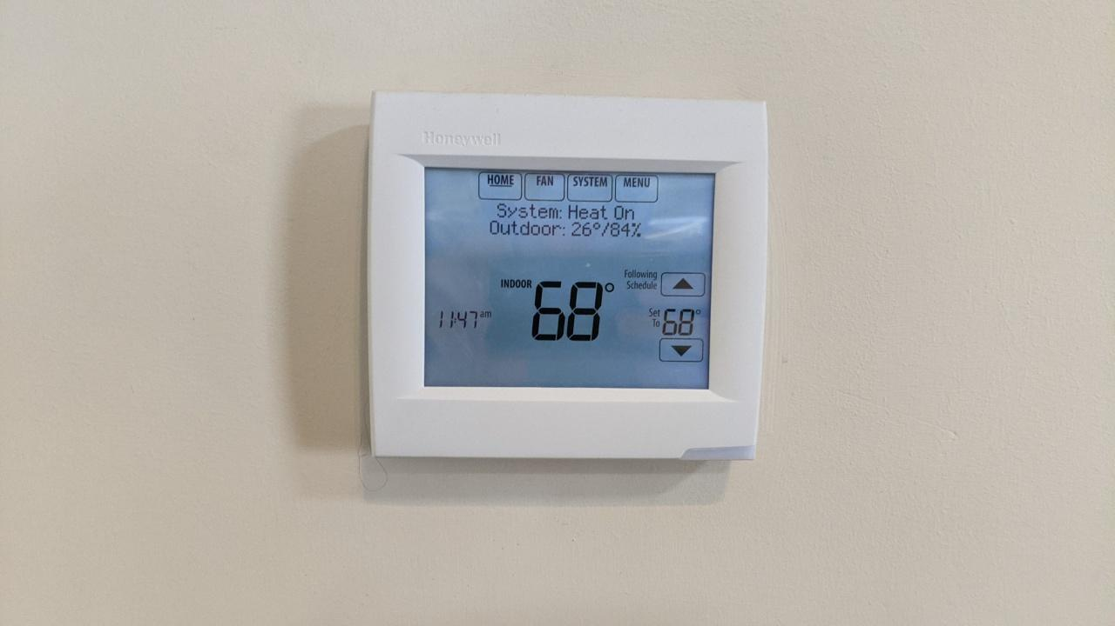
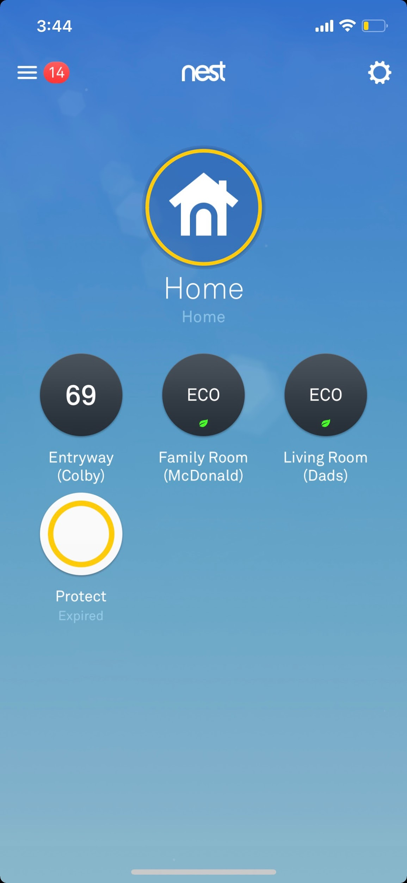
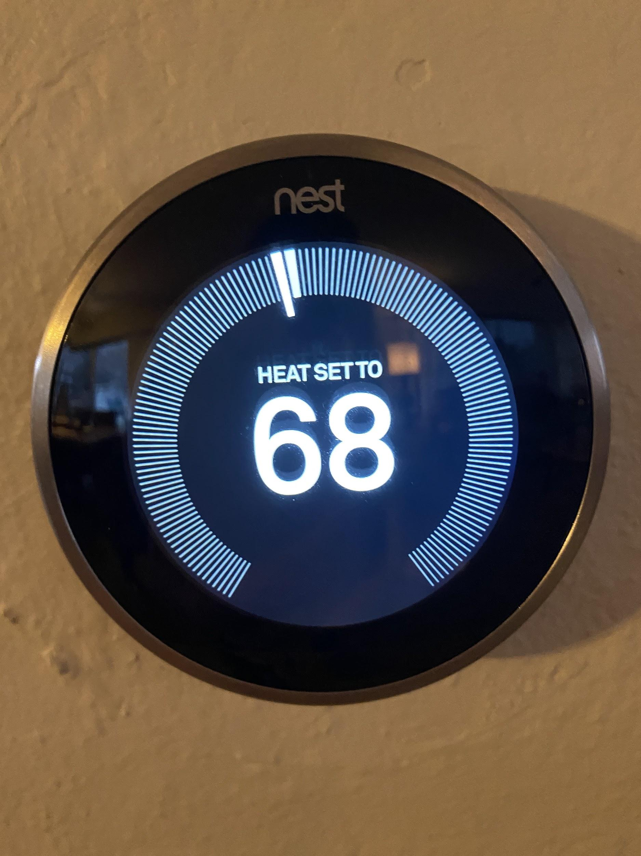
Top: Honeywell thermostat controlled by Samsung SmartThings app.
Right: screenshot of the Nest app used to monitor the Nest thermostat of 3 homes.
Top: Sensor for garage door. For this user, it is set to send an alert if open for more then 2 hours. Can be closed from its app.
Right: Status indicated in the SmartThings app.

Slide 16
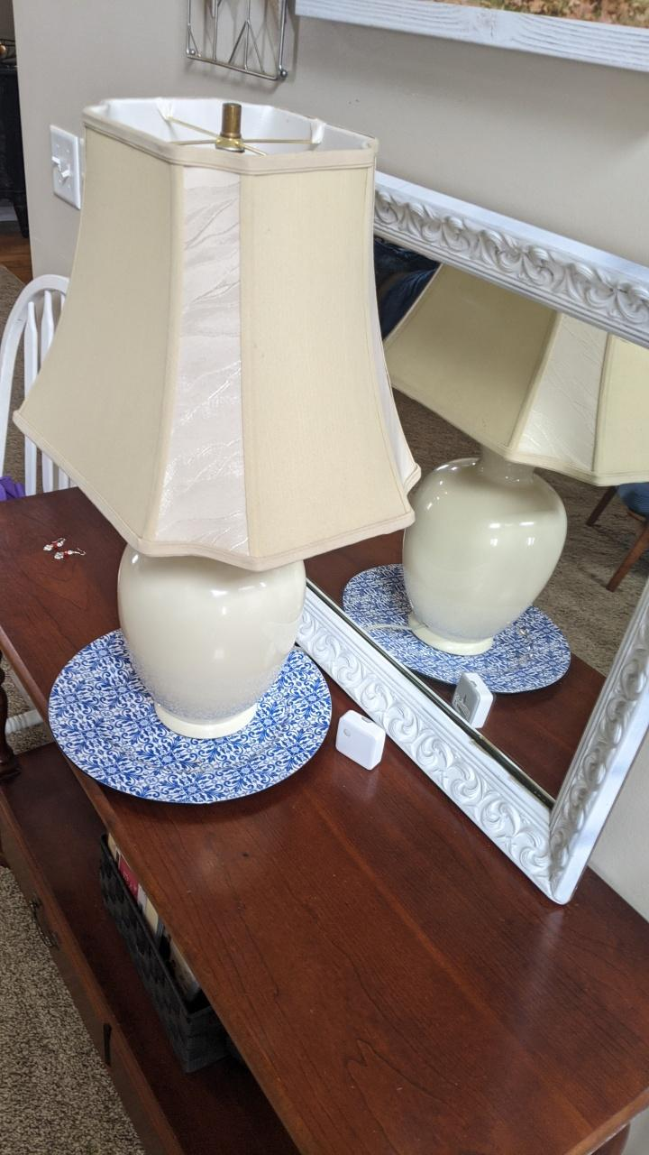
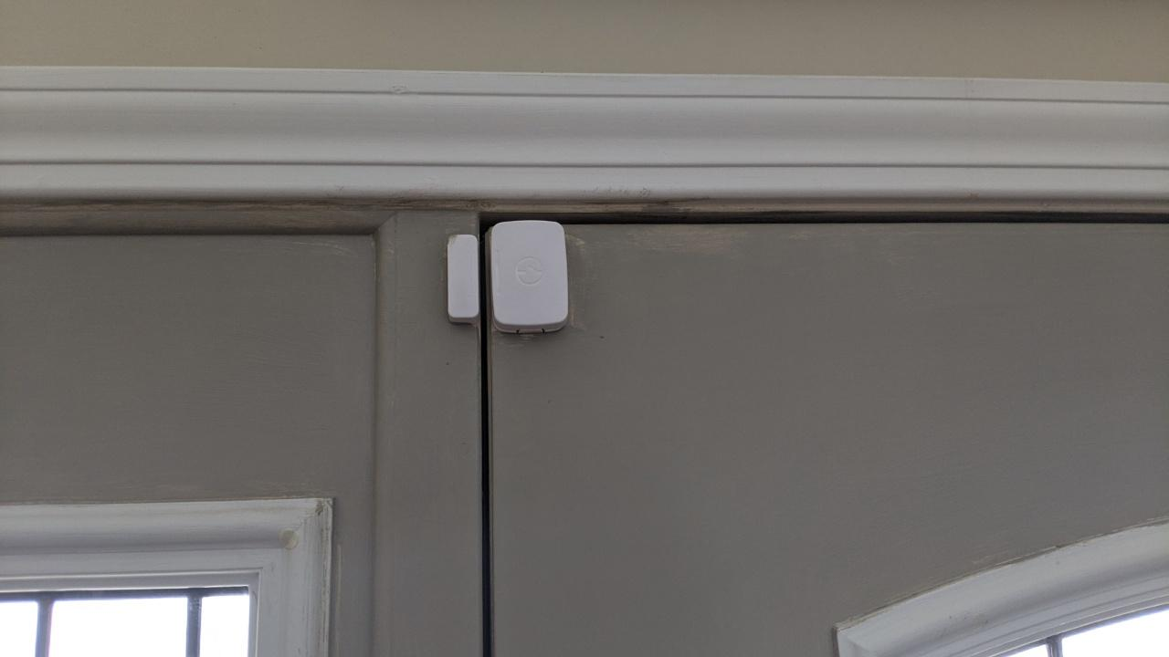
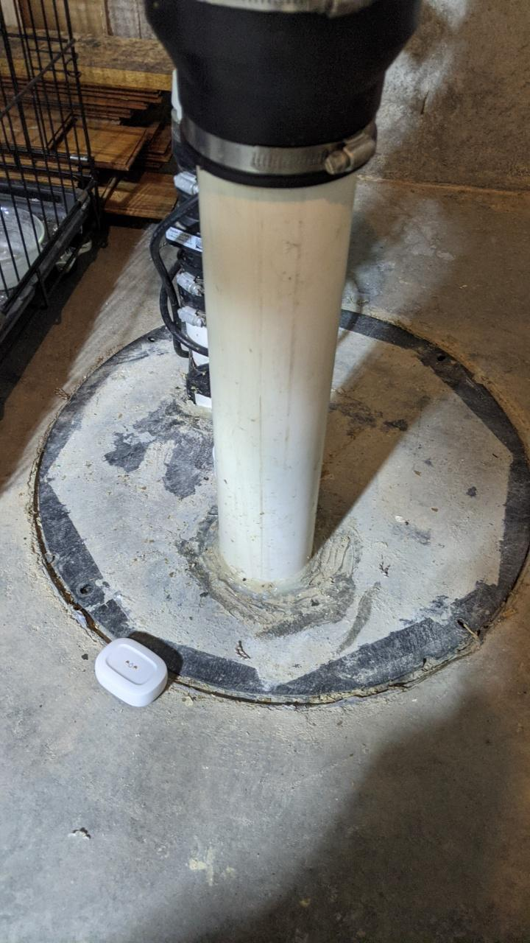
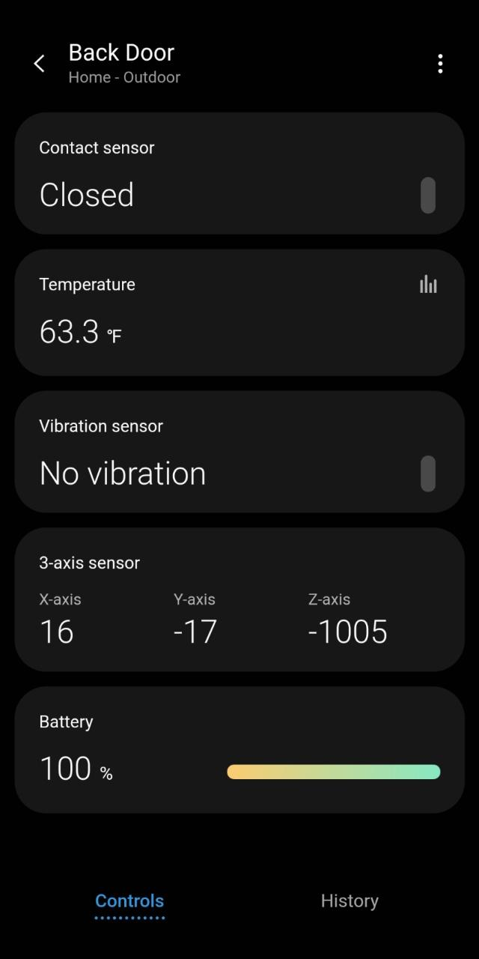
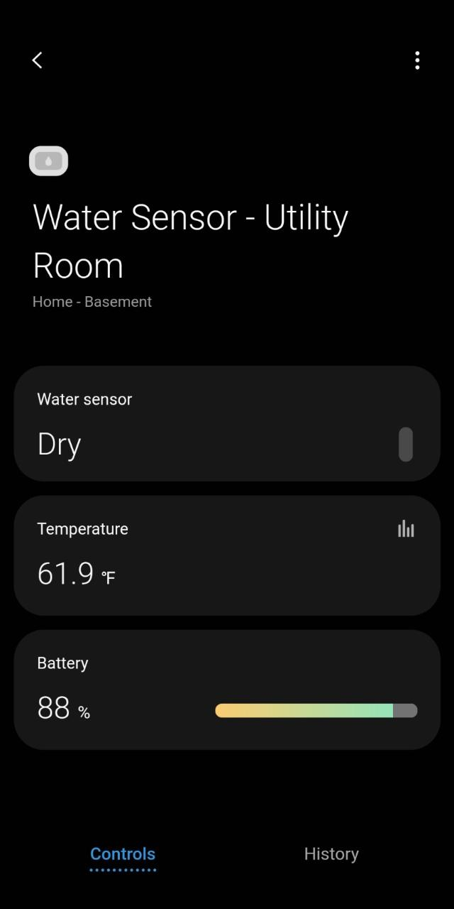
Left: Door sensor with screenshot of app showing door status - closed.
Center: Water Sensor with screenshot of app showing status of: Dry.
This motion light & lamp combo is set to automatically give a high school student light when going downstairs to do chores early in the morning. (He gets up earlier then the rest of the family).
When the family leaves for a long weekend, it will be connected to the Samsung SmartThing Security System. Any motion will trigger it to send an alert to the owner.

Slide 17
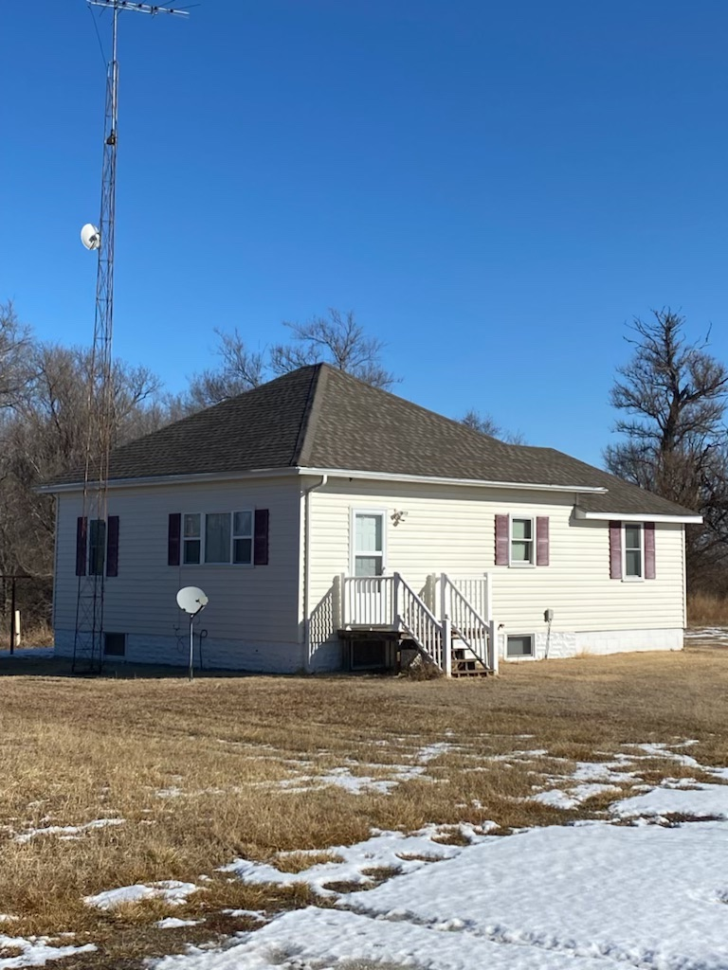
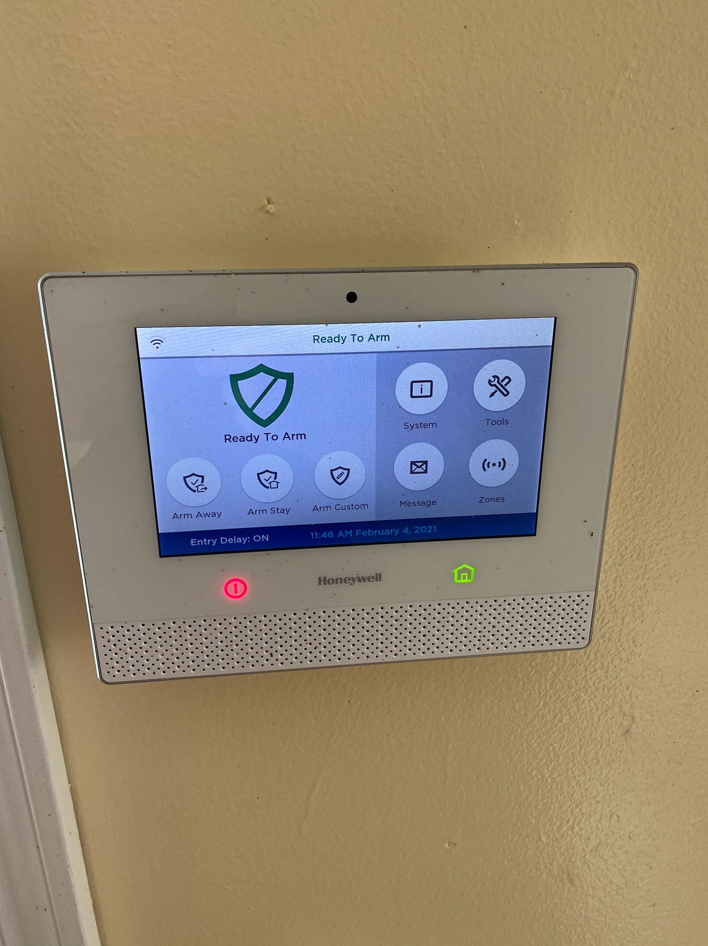
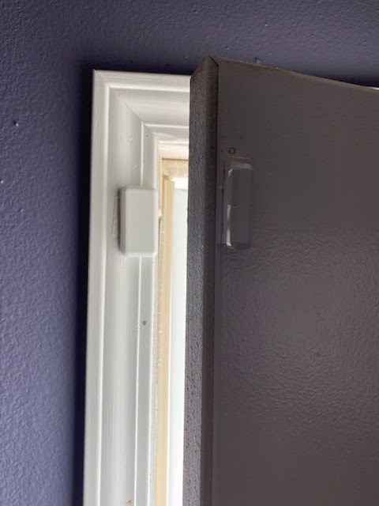
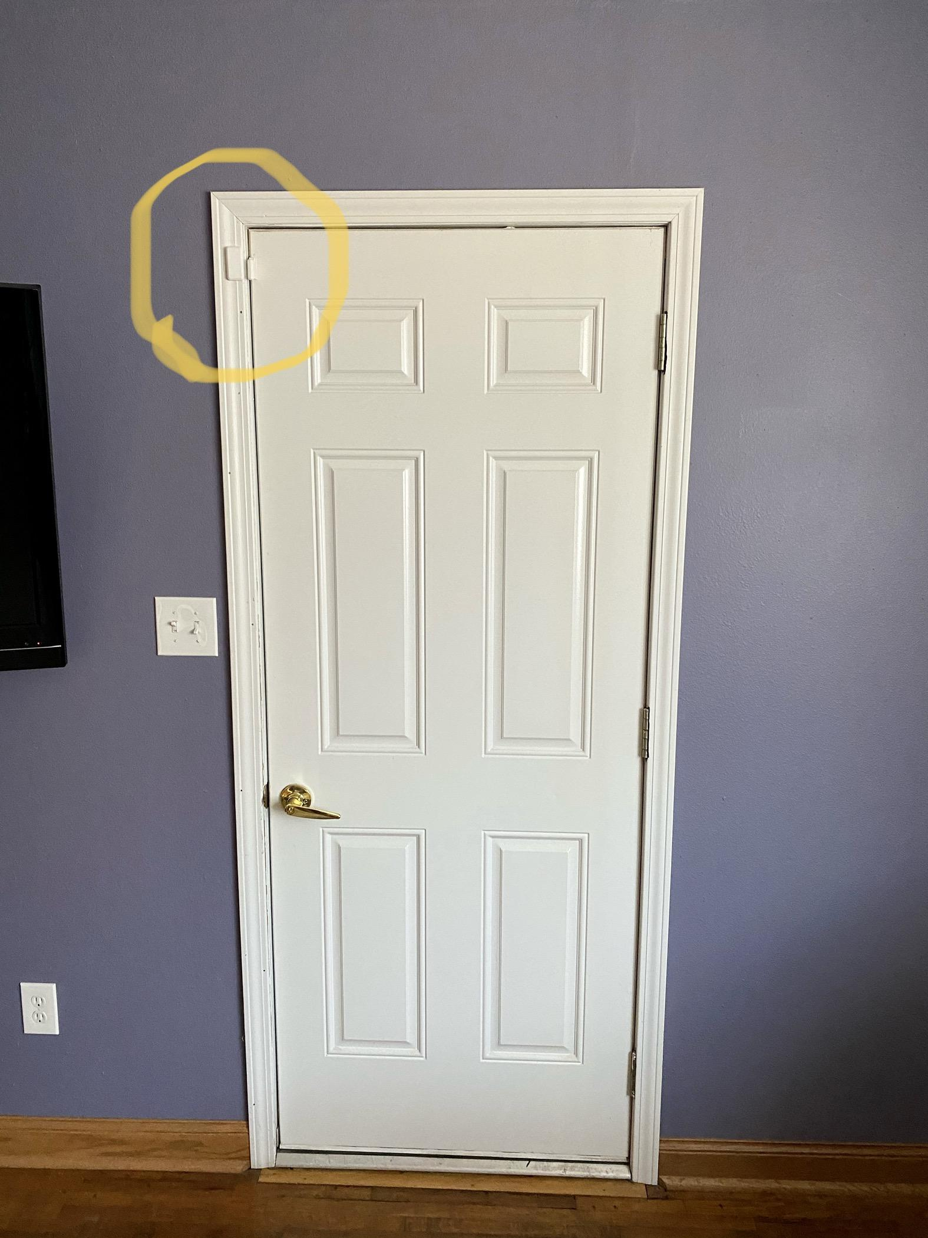
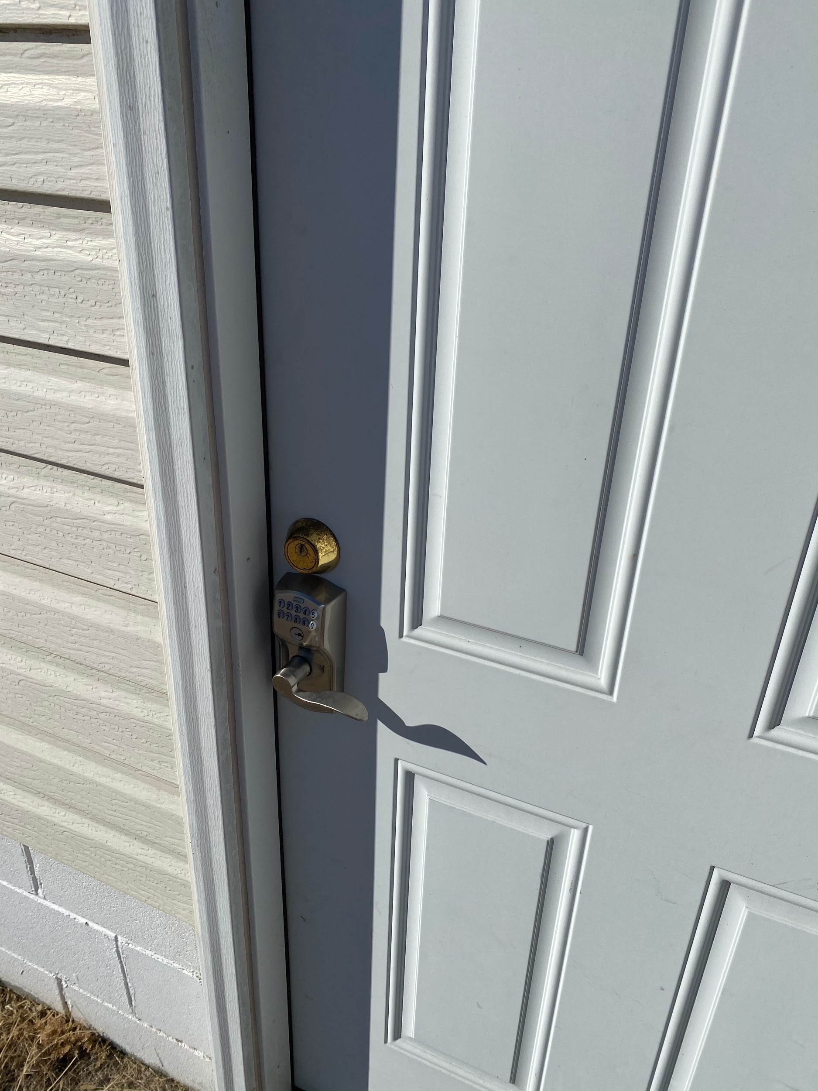
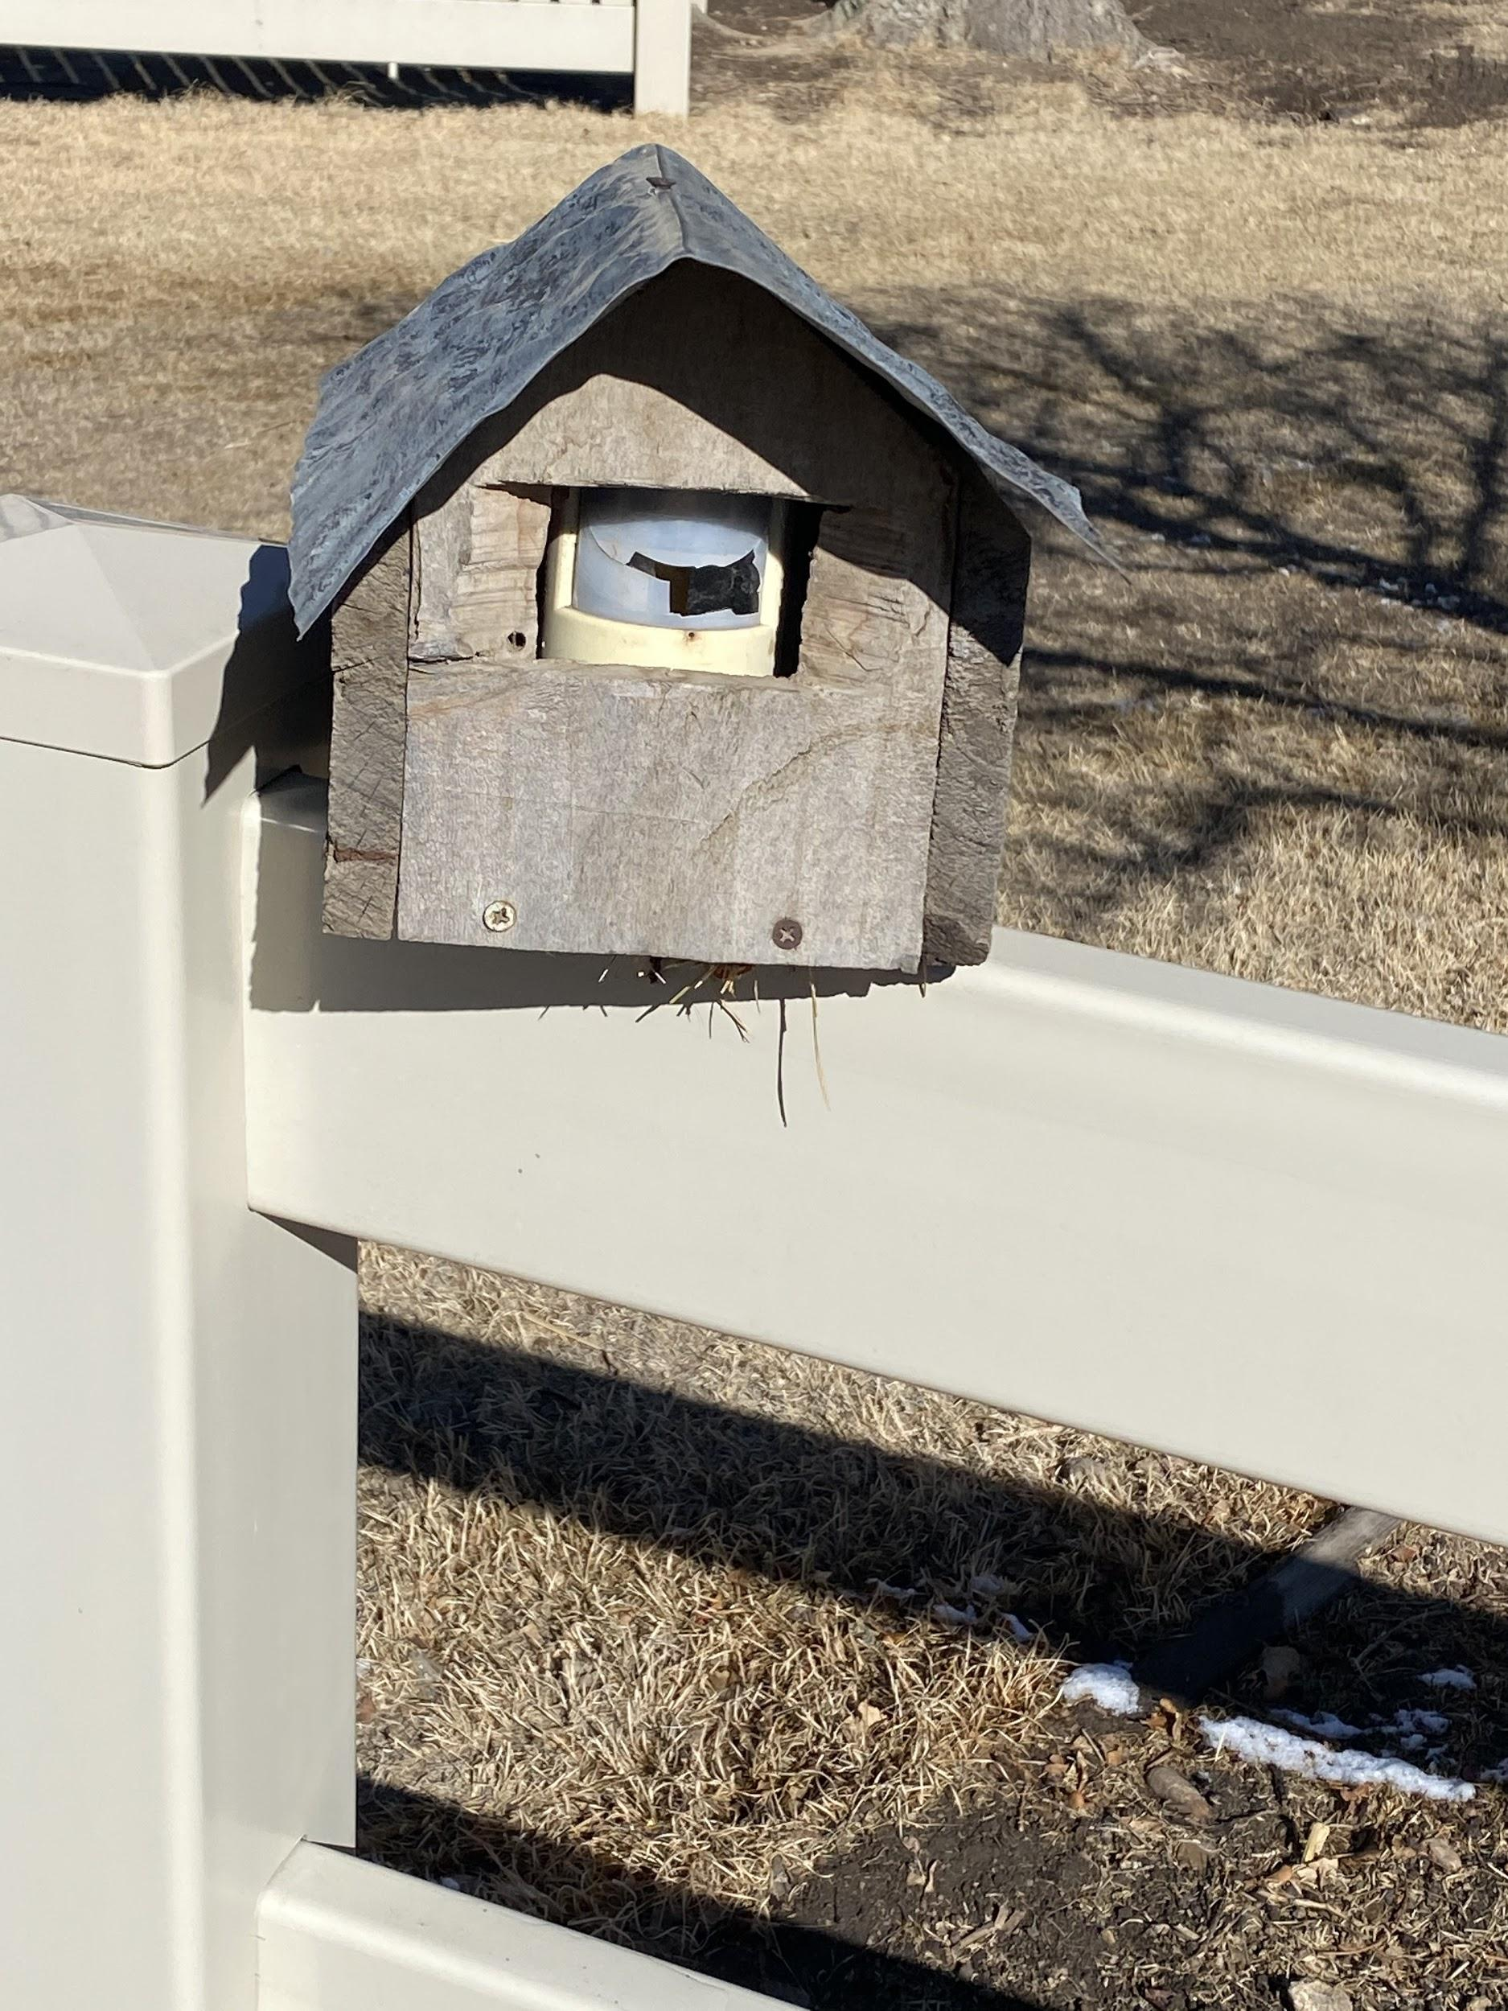
This hunting cabin is set up with a security system by a local internet provider.
Right: Alarm inside door to enter security code. If the incorrect code is entered, security will call cabin owner.
Door has keyless entry.
Be creative: - hide your sensor or camera!
Door has a sensor to alert the system when it is opened and closed.

Slide 18
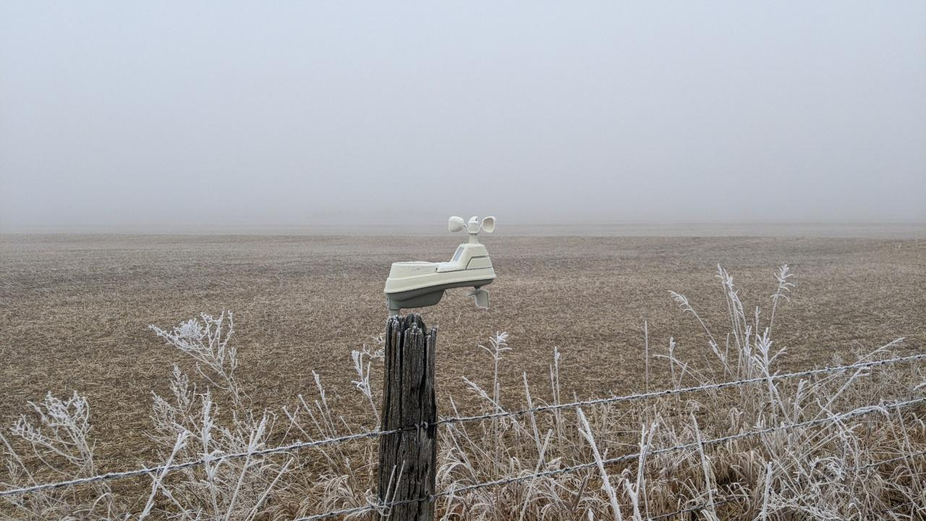
AcuRite - Weather Alert System provides information on:
rain gauge,
wind speed,
wind direction,
temperature, and humidity.
Works with AcuRite App to track history.
You can customize alerts to include: wind gust, low or high temperature warnings, rain alerts, UV index, lightning strikes.

Slide 19
Gate Openers
Swing or slide options
Power options: battery (energy can come from a solar panel kit)
open with a remote or drive over Wired Vehicle Sensor.
Some offer an app that works with Bluetooth.

Slide 20
Irrigation monitoring systems (ex: AgSense or Valley 365) can save a farmer manpower, gas, wear on vehicles and lots of time when having to oversee multiple systems. They provide alerts to problems with water pressure, system lack of movement, sprinkle head plugs etc.
It is expensive but using the smart apps saves a lot of resources in the long run .

Slide 21
When WiFi is not available.
Solar panel to pump water in a pasture.
Heated Water Bucket
Heated Pet Bowl
Heat lamp for chickens, dogs and cats.
2 plug Thermostatically Controlled Outlet
Thermo Cube Display

Slide 22
Not ready to take away
Grandpa’s (Grandma’s) tractor keys
Safety Considerations
Medical Alert Systems - work where there is Cell Service. https://www.caring.com/best-medical-alert-systems/
Implement manufacturer support:
Operation Center - John Deere
Advance Farming Solution (AFS Connect) - CASE IH
PML Connect - New Holland
Standard on new tractors, sprayers and combines with a yearly fee.
Find My Phone
Set up in mobile phone settings and download app
Pin Location
Use Maps or Google Maps to “Pin” your location and text to a contact.

Slide 23
Come see the
Kansas AgrAbility Booth
in the
Exhibit Hall
Wednesday Feb 10
Booth: 2:00 – 2:30 PM
Booth: 3:30 – 4:00 PM
Thursday, Feb. 11
Booth: 2:00 – 2:30 PM
Booth: 3:30 – 4:00 PM
Friday, Feb 12
Booth: 10:00 - 10:30 AM
Booth: 11:30 – Noon

Slide 24
Website: www.agrability.ksu.edu
Email: agrability@ksu.edu
Phone: 1-800-KAN-DO IT
Cassie Ramon - North Central/Northeast
Email: cramon@occk.com
Karin Rasmussen - Western
Email: krasmussen@nkesc.org
Lesa Clubine - Southeast
Email: lesa@skilonline.com
The Kansas AgrAbility Project's primary purpose is to directly assist Kansas farmers/ranchers, their employees, and family members who have become injured, have a health condition, or a disability to remain actively engaged in production agriculture for as long as they choose.
National AgrAbility Project
www.agrability.org
Funded By USDA-NIFA, Special Project Number 2018-41590-28719 through USDA-NIFA.

